Slide 1

Chapter 20 Deep Generative Models
20 Deep Generative Models
Acknowledge to: Wenxue Liu
Organizers: Guoqiang Zhong, Zhaoyang Niu
Machine Learning Research Group
Ocean University of China
Qingdao, China
https://github.com/AdolfKing/DeepLearningSlides

Slide 2

Chapter 20 Deep Generative Models
20.1 Boltzmann Machines
20.2 Restricted Boltzmann Machines
20.3 Deep Belief Networks
20.4 Deep Boltzmann Machines
20.5 Boltzmann Machines for Real-Valued Data
20.6 Convolutional Boltzmann Machines
20.7 Boltzmann Machines for Structured or Sequential Outputs
20.8 Other Boltzmann Machines
20.9 Back-Propagation through Random Operations
20.10 Directed Generative Nets
20.11 Drawing Samples from Autoencoders
20.12 Generative Stochastic Networks
20.13 Other Generation Schemes
20.14 Evaluating Generative Models
20.15 Conclusion

Slide 3
20 Deep Generative Models
In this chapter, we present several of the speciﬁc kinds of generative models that can be built and trained using the techniques presented in Chapters 16, 17, 18 and 19. All of these models represent probability distributions over multiple variables in some way. Some allow the probability distribution function to be evaluated explicitly. Others do not allow the evaluation of the probability distribution function, but support operations that implicitly require knowledge of it, such as drawing samples from the distribution. Some of these models are structured probabilistic models described in terms of graphs and factors, using the language of graphical models presented in Chapter 16. Others can not easily be described in terms of factors, but represent probability distributions nonetheless.

Slide 4
Chapter 20 Deep Generative Models
20.1 Boltzmann Machines
Acknowledge to: Wenxue Liu
Organizers: Guoqiang Zhong, Zhaoyang Niu
Machine Learning Research Group
Ocean University of China
Qingdao, China
https://github.com/AdolfKing/DeepLearningSlides

Slide 5
20.1 Boltzmann Machines
Boltzmann machines were originally introduced as a general “connectionist” approach to learning arbitrary probability distributions over binary vectors (Fahlman et al., 1983; Ackley et al., 1985; Hinton et al., 1984; Hinton and Sejnowski, 1986). Variants of the Boltzmann machine that include other kinds of variables have long ago surpassed the popularity of the original. In this section we brieﬂy introduce the binary Boltzmann machine and discuss the issues that come up when trying to train and perform inference in the model.

Slide 6
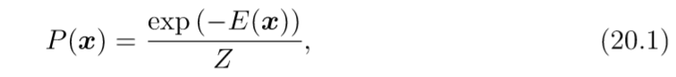
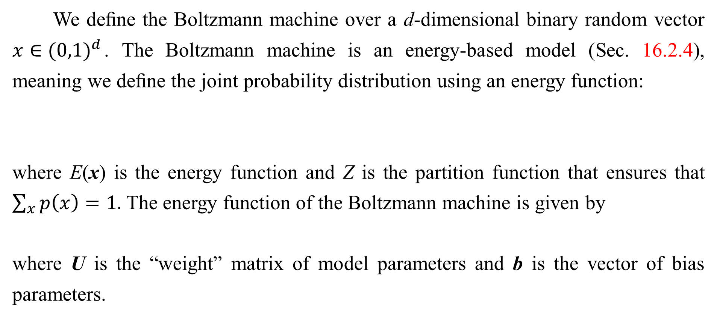
20.1 Boltzmann Machines
We deﬁne the Boltzmann machine over a d-dimensional binary random vector $x∈{(0,1)}^{d}$. The Boltzmann machine is an energy-based model (Sec. 16.2.4), meaning we deﬁne the joint probability distribution using an energy function:
where E(x) is the energy function and Z is the partition function that ensures that $\sum_{x}{p\left(x\right)=1.}$ The energy function of the Boltzmann machine is given by
where U is the “weight” matrix of model parameters and b is the vector of bias parameters.

Slide 7
20.1 Boltzmann Machines
In the general setting of the Boltzmann machine, we are given a set of training examples, each of which are n-dimensional. Eq. 20.1 describes the joint probability distribution over the observed variables. While this scenario is certainly viable, it does limit the kinds of interactions between the observed variables to those described by the weight matrix. Speciﬁcally, it means that the probability of one unit being on is given by a linear model (logistic regression) from the values of the other units.

Slide 8
20.1 Boltzmann Machines
The Boltzmann machine becomes more powerful when not all the variables are observed. In this case, the non-observed variables, or latent variables, can act similarly to hidden units in a multi-layer perceptron and model higher-order interactions among the visible units. Just as the addition of hidden units to convert logistic regression into an MLP results in the MLP being a universal approximator of functions, a Boltzmann machine with hidden units is no longer limited to modeling linear relationships between variables. Instead, the Boltzmann machine becomes a universal approximator of probability mass functions over discrete variables (Le Roux and Bengio, 2008).

Slide 9
20.1 Boltzmann Machines
Formally, we decompose the units x into two subsets: the visible units v and the latent (or hidden) units h. The energy function becomes
Boltzmann Machine Learning Learning algorithms for Boltzmann machines are usually based on maximum likelihood. All Boltzmann machines have an intractable partition function, so the maximum likelihood gradient must be approximated using the techniques described in Chapter 18.

Slide 10
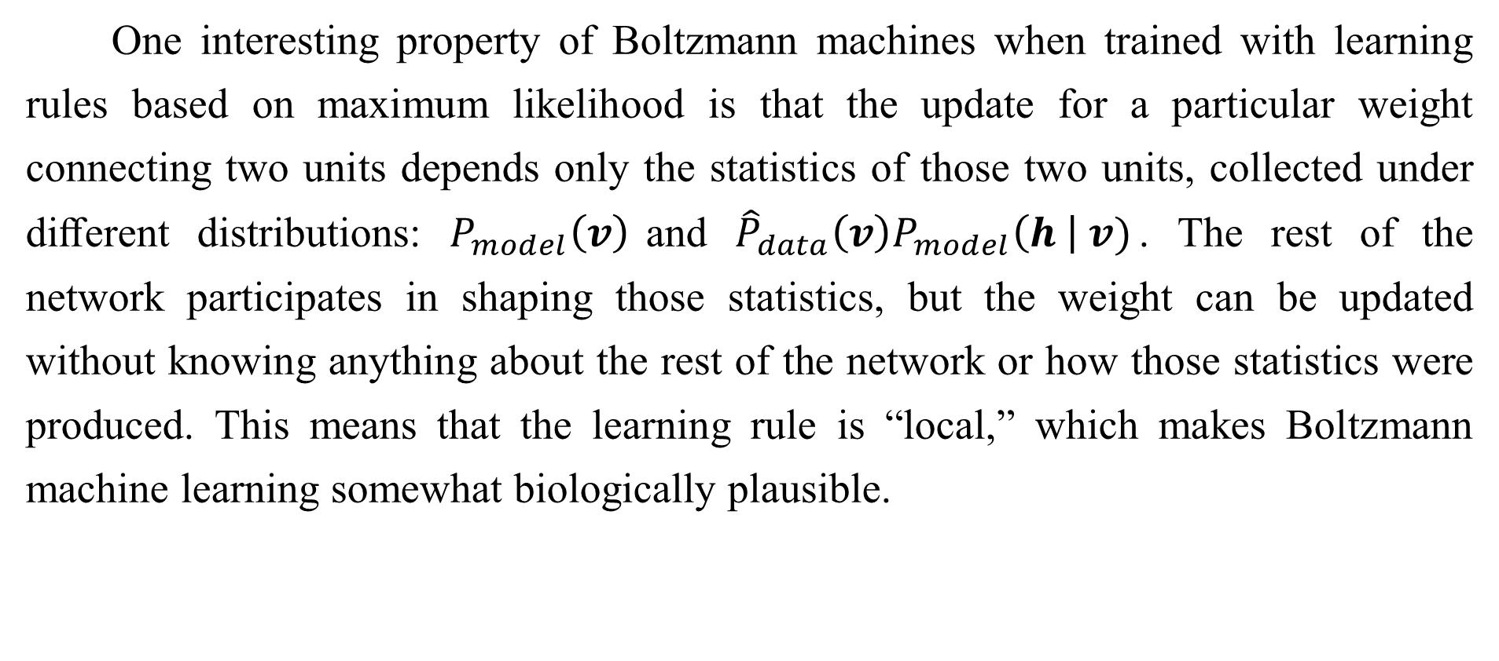
20.1 Boltzmann Machines
One interesting property of Boltzmann machines when trained with learning rules based on maximum likelihood is that the update for a particular weight connecting two units depends only the statistics of those two units, collected under diﬀerent distributions: $P_{model}\left(v\right)$and ${\hat{P}}_{data}\left(v\right)P_{model}\left(h \right| v)$. The rest of the network participates in shaping those statistics, but the weight can be updated without knowing anything about the rest of the network or how those statistics were produced. This means that the learning rule is “local,” which makes Boltzmann machine learning somewhat biologically plausible.

Slide 11
20.1 Boltzmann Machines
It is conceivable that if each neuron were a random variable in a Boltzmann machine, then the axons and dendrites connecting two random variables could learn only by observing the ﬁring pattern of the cells that they actually physically touch. In particular, in the positive phase, two units that frequently activate together have their connection strengthened. This is an example of a Hebbian learning rule (Hebb, 1949) often summarized with the mnemonic “ﬁre together, wire together.” Hebbian learning rules are among the oldest hypothesized explanations for learning in biological systems and remain relevant today (Giudice et al., 2009).

Slide 12
20.1 Boltzmann Machines
Other learning algorithms that use more information than local statistics seem to require us to hypothesize the existence of more machinery than this. For example, for the brain to implement back-propagation in a multilayer perceptron, it seems necessary for the brain to maintain a secondary communication network for transmitting gradient information backwards through the network. Proposals for biologically plausible implementations (and approximations) of back-propagation have been made (Hinton, 2007a; Bengio, 2015) but remain to be validated, and Bengio (2015) links back-propagation of gradients to inference in energy-based models similar to the Boltzmann machine (but with continuous latent variables).

Slide 13
20.1 Boltzmann Machines
The negative phase of Boltzmann machine learning is somewhat harder to explain from a biological point of view. As argued in Sec. 18.2, dream sleep may be a form of negative phase sampling. This idea is more speculative though.

Slide 14
Chapter 20 Deep Generative Models
20.2 Restricted Boltzmann Machines
Acknowledge to: Wenxue Liu
Organizers: Guoqiang Zhong, Zhaoyang Niu
Machine Learning Research Group
Ocean University of China
Qingdao, China
https://github.com/AdolfKing/DeepLearningSlides

Slide 15
20.2 Restricted Boltzmann Machines
Invented under the name harmonium (Smolensky, 1986), restricted Boltzmann machines are some of the most common building blocks of deep probabilistic models. We have brieﬂy described RBMs previously, in Sec. 16.7.1. Here we review the previous information and go into more detail. RBMs are undirected probabilistic graphical models containing a layer of observable variables and a single layer of latent variables. RBMs may be stacked (one on top of the other) to form deeper models. See Fig. 20.1 for some examples. In particular, Fig. 20.1a shows the graph structure of the RBM itself. It is a bipartite graph, with no connections permitted between any variables in the observed layer or between any units in the latent layer.

Slide 16
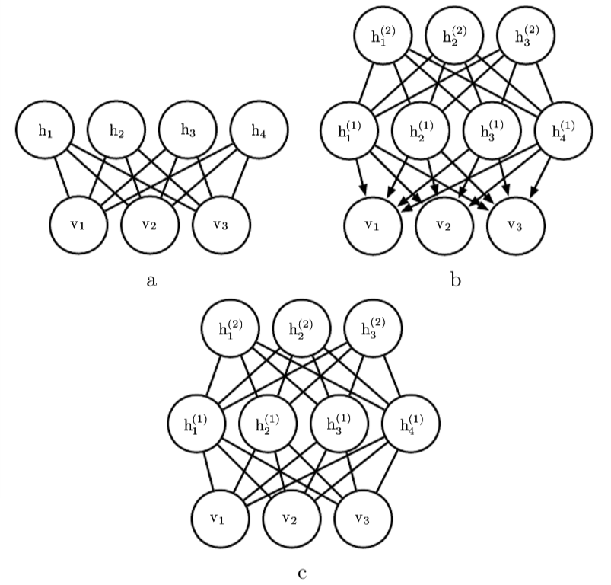
20.2 Restricted Boltzmann Machines
Figure 20.1: Examples of models that may be built with restricted Boltzmann machines. (a) The restricted Boltzmann machine itself is an undirected graphical model based on a bipartite graph, with visible units in one part of the graph and hidden units in the other part. There are no connections among the visible units, nor any connections among the hidden units. Typically every visible unit is connected to every hidden unit but it is possible to construct sparsely connected RBMs such as convolutional RBMs.

Slide 17
20.2 Restricted Boltzmann Machines
Figure 20.1: (b) A deep belief network is a hybrid graphical model involving both directed and undirected connections. Like an RBM, it has no intra-layer connections. However, a DBN has multiple hidden layers, and thus there are connections between hidden units that are in separate layers. All of the local conditional probability distributions needed by the deep belief network are copied directly from the local conditional probability distributions of its constituent RBMs. Alternatively, we could also represent the deep belief network with a completely undirected graph, but it would need intra-layer connections to capture the dependencies between parents.

Slide 18
20.2 Restricted Boltzmann Machines
Figure 20.1: (c) A deep Boltzmann machine is an undirected graphical model with several layers of latent variables. Like RBMs and DBNs, DBMs lack intra-layer connections. DBMs are less closely tied to RBMs than DBNs are. When initializing a DBM from a stack of RBMs, it is necessary to modify the RBM parameters slightly. Some kinds of DBMs may be trained without ﬁrst training a set of RBMs.

Slide 19
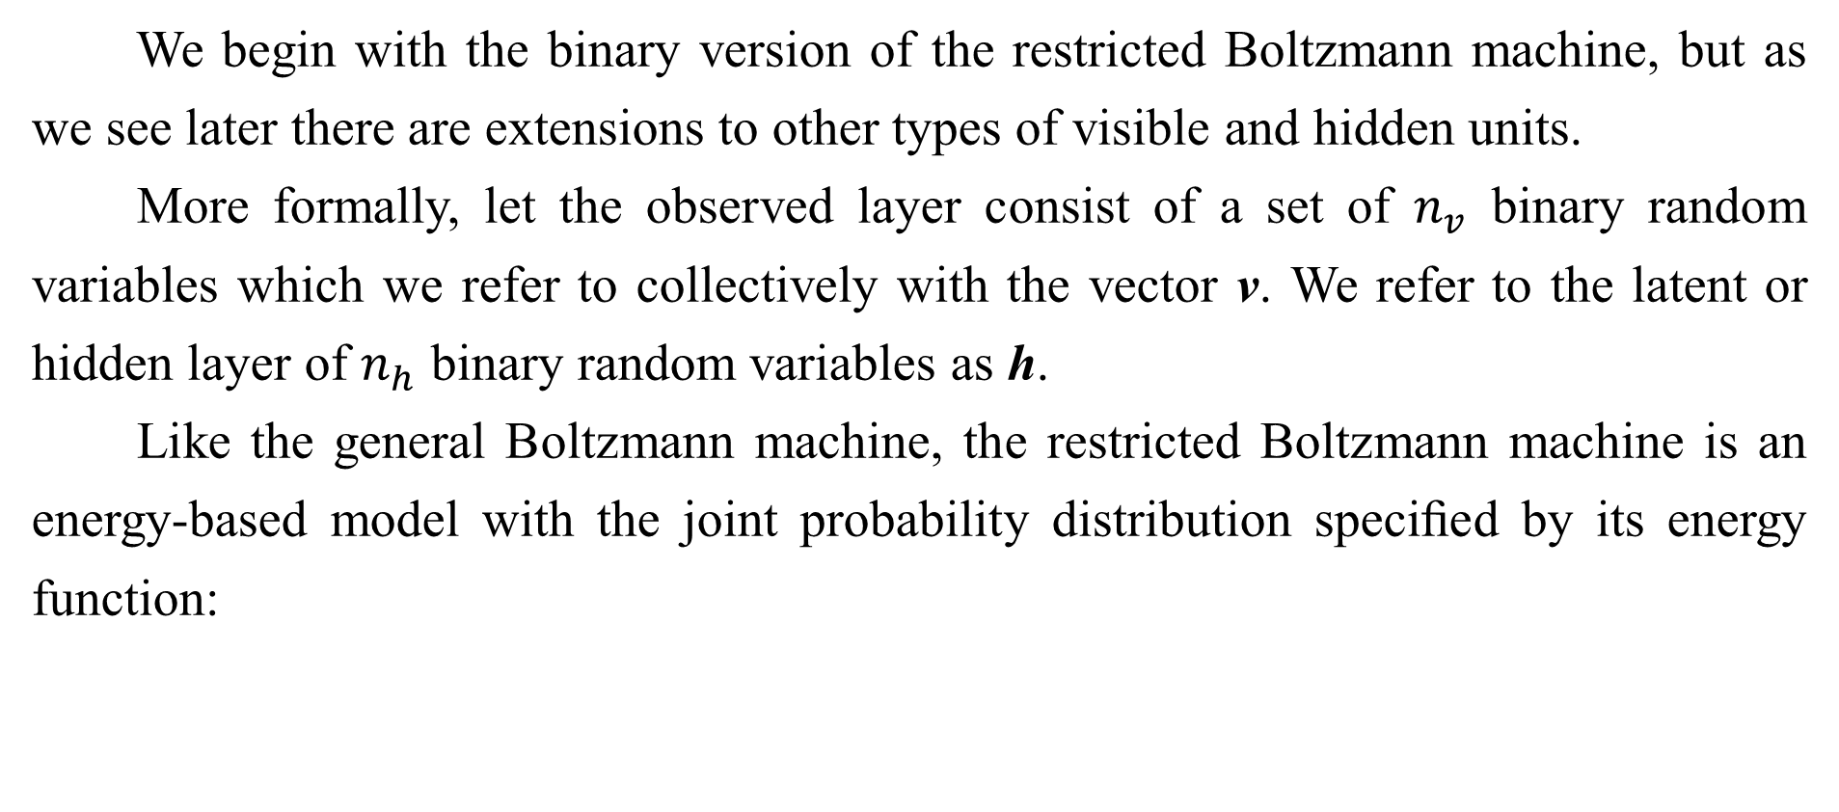
20.2 Restricted Boltzmann Machines
We begin with the binary version of the restricted Boltzmann machine, but as we see later there are extensions to other types of visible and hidden units.
More formally, let the observed layer consist of a set of $n_{v}$ binary random variables which we refer to collectively with the vector v. We refer to the latent or hidden layer of $n_{h}$ binary random variables as h.
Like the general Boltzmann machine, the restricted Boltzmann machine is an energy-based model with the joint probability distribution speciﬁed by its energy function:

Slide 20
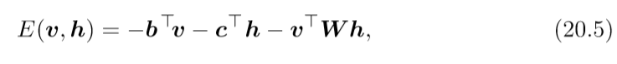
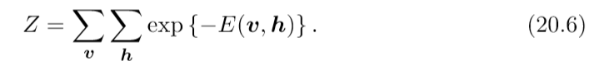
20.2 Restricted Boltzmann Machines
The energy function for an RBM is given by
and Z is the normalizing constant known as the partition function:

Slide 21
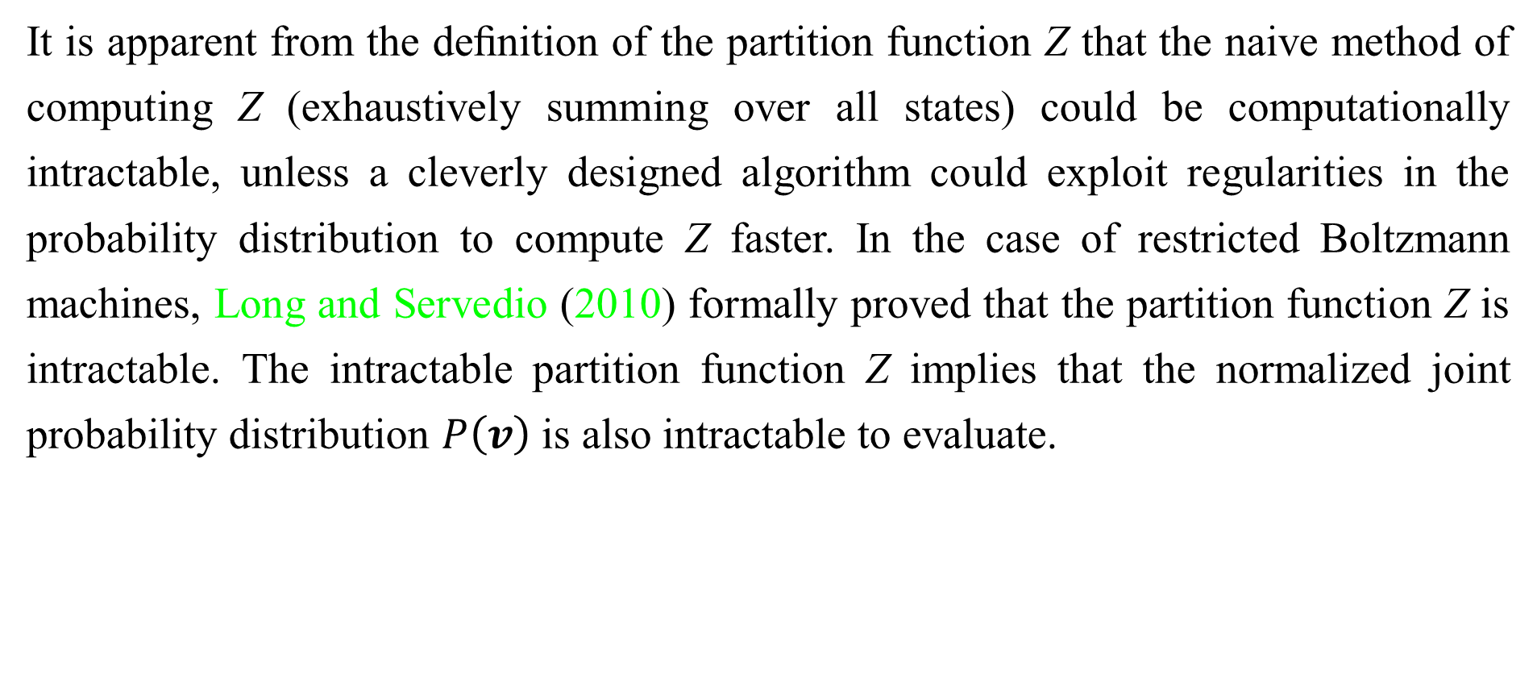
20.2 Restricted Boltzmann Machines
It is apparent from the deﬁnition of the partition function Z that the naive method of computing Z (exhaustively summing over all states) could be computationally intractable, unless a cleverly designed algorithm could exploit regularities in the probability distribution to compute Z faster. In the case of restricted Boltzmann machines, Long and Servedio (2010) formally proved that the partition function Z is intractable. The intractable partition function Z implies that the normalized joint probability distribution $P\left(v\right)$is also intractable to evaluate.

Slide 22
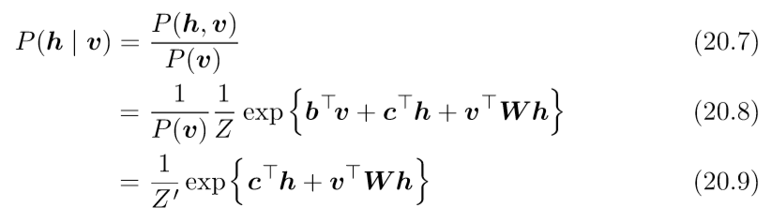
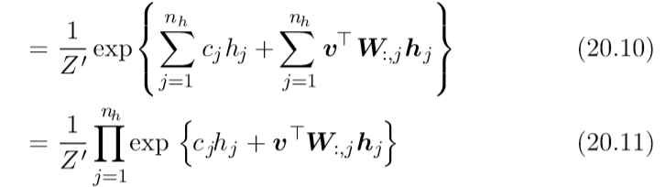
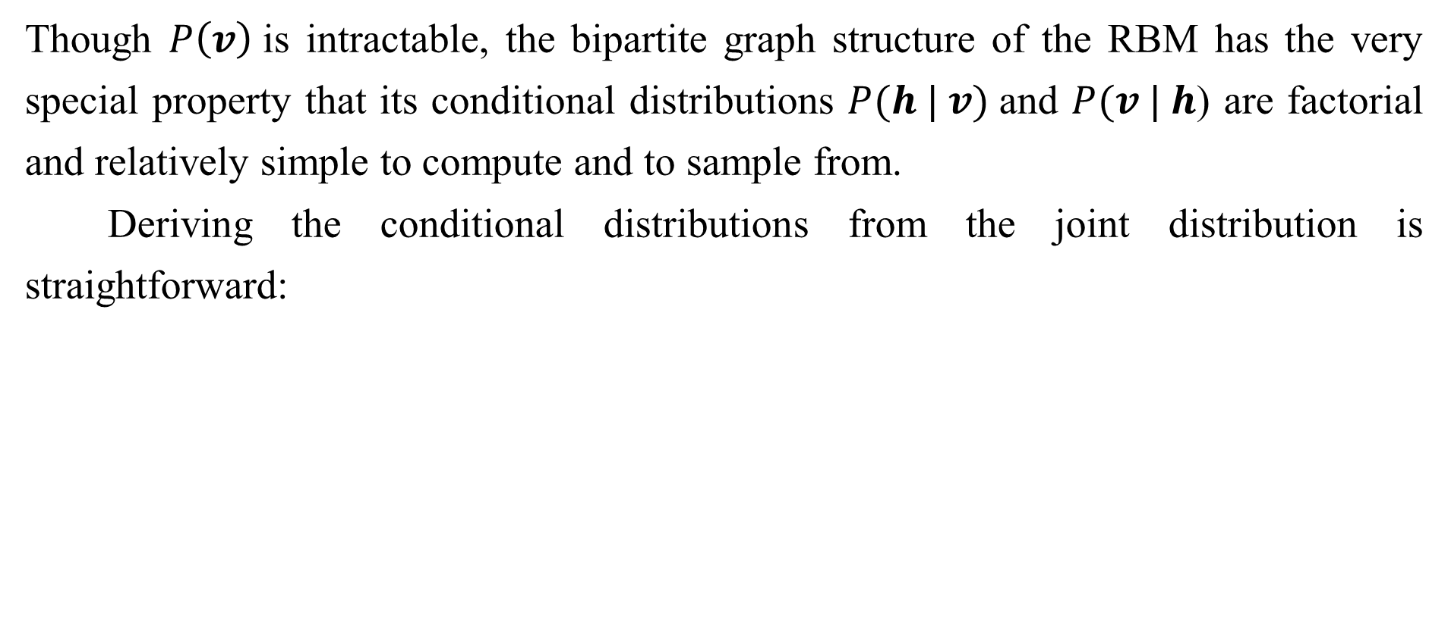
20.2.1 Conditional Distributions
Though $P\left(v\right)$is intractable, the bipartite graph structure of the RBM has the very special property that its conditional distributions $P(h | v)$and $P(v | h$) are factorial and relatively simple to compute and to sample from.
Deriving the conditional distributions from the joint distribution is straightforward:

Slide 23
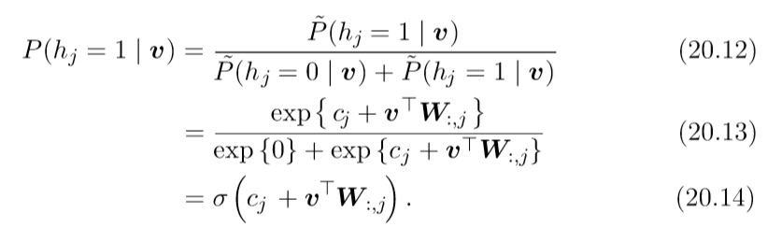
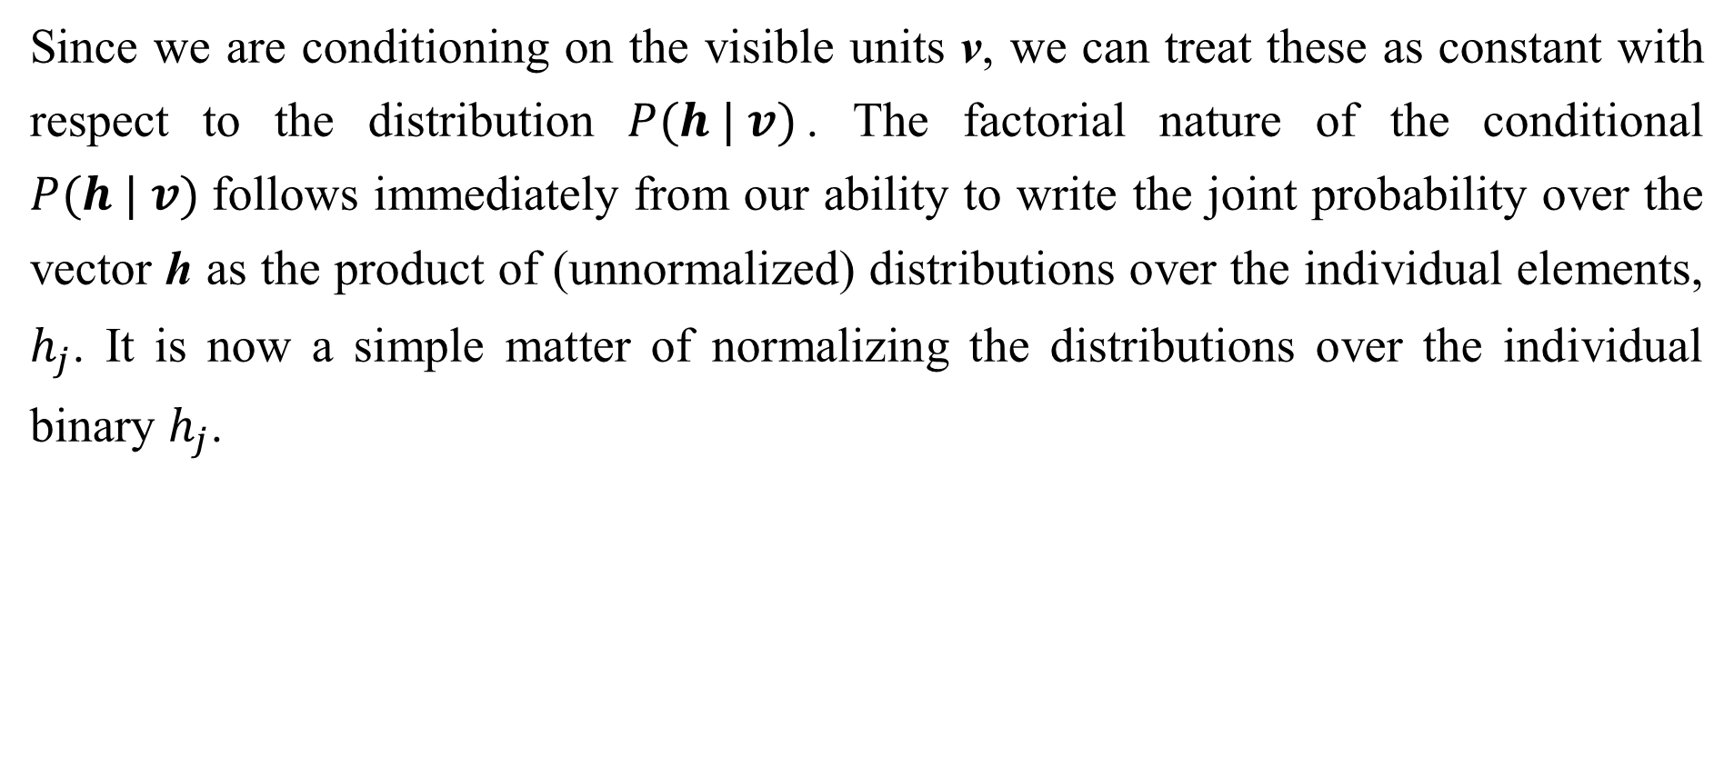
20.2.1 Conditional Distributions
Since we are conditioning on the visible units v, we can treat these as constant with respect to the distribution $P(h | v)$. The factorial nature of the conditional $P(h | v)$follows immediately from our ability to write the joint probability over the vector h as the product of (unnormalized) distributions over the individual elements, $h_{j}$. It is now a simple matter of normalizing the distributions over the individual binary $h_{j}$.

Slide 24
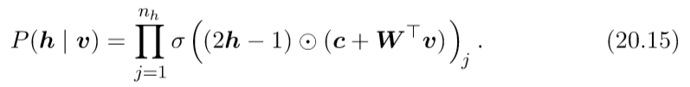
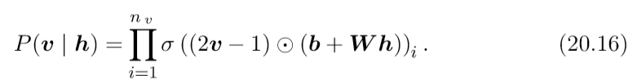
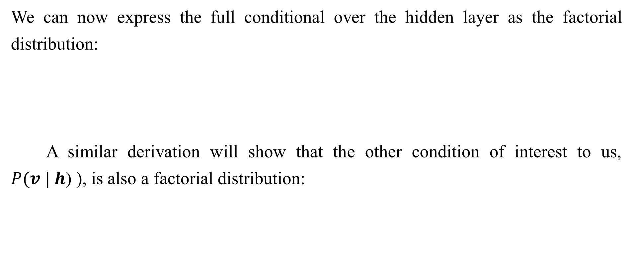
20.2.1 Conditional Distributions
We can now express the full conditional over the hidden layer as the factorial distribution:
A similar derivation will show that the other condition of interest to us, $P(v | h$) ), is also a factorial distribution:

Slide 25
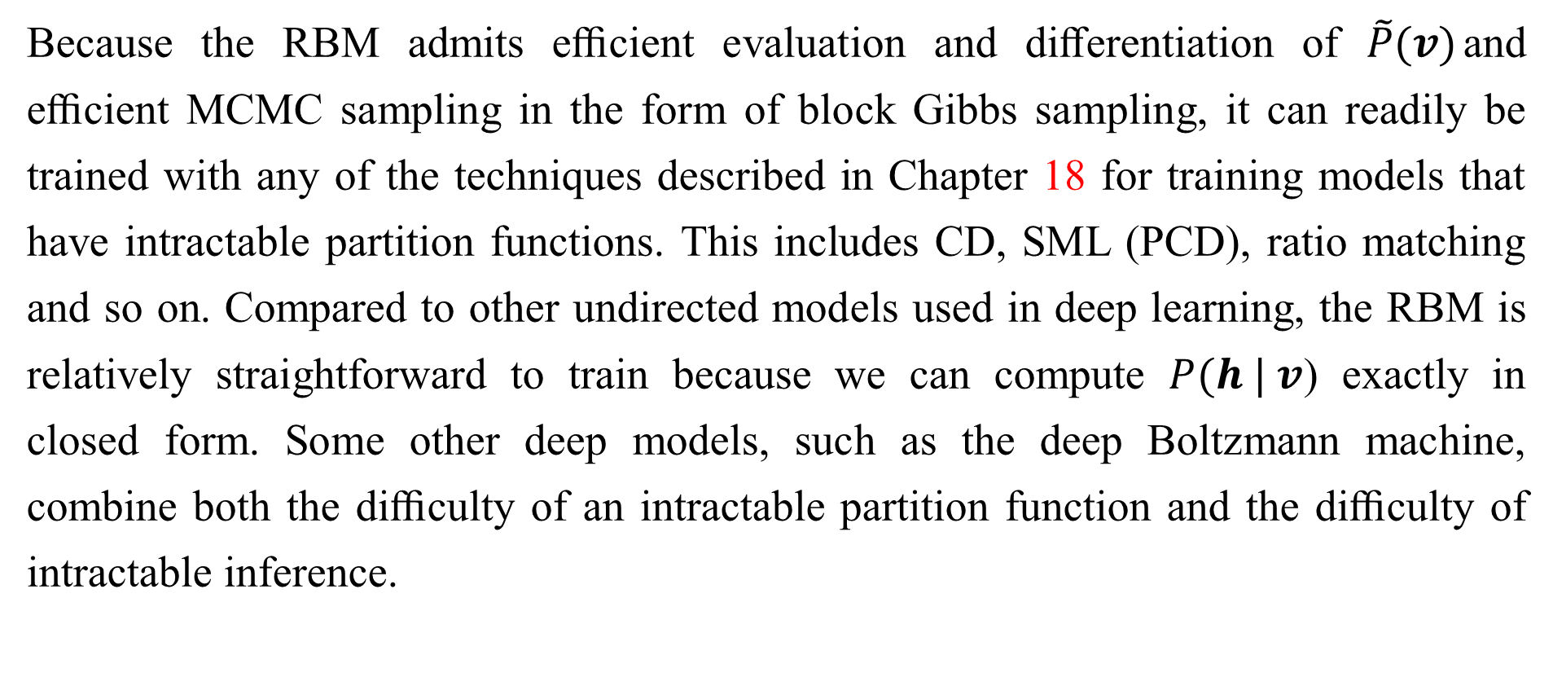
20.2.2 Training Restricted Boltzmann Machines
Because the RBM admits eﬃcient evaluation and diﬀerentiation of $\tilde{P}(v)$and eﬃcient MCMC sampling in the form of block Gibbs sampling, it can readily be trained with any of the techniques described in Chapter 18 for training models that have intractable partition functions. This includes CD, SML (PCD), ratio matching and so on. Compared to other undirected models used in deep learning, the RBM is relatively straightforward to train because we can compute $P(h | v$) exactly in closed form. Some other deep models, such as the deep Boltzmann machine, combine both the diﬃculty of an intractable partition function and the diﬃculty of intractable inference.

Slide 26
Chapter 20 Deep Generative Models
20.3 Deep Belief Networks
Acknowledge to: Guohua Yue
Organizers: Guoqiang Zhong, Zhaoyang Niu
Machine Learning Research Group
Ocean University of China
Qingdao, China
https://github.com/AdolfKing/DeepLearningSlides

Slide 27
20.3 Deep Belief Networks
Deep belief networks (DBNs) were one of the first non-convolutional models to successfully admit training of deep architectures (Hinton et al., 2006; Hinton, 2007b). The introduction of deep belief networks in 2006 began the current deep learning renaissance. Prior to the introduction of deep belief networks, deep models were considered too difficult to optimize. Kernel machines with convex objective functions dominated the research landscape. Deep belief networks demonstrated that deep architectures can be successful, by outperforming kernelized support vector machines on the MNIST dataset (Hinton et al., 2006). Today, deep belief networks have mostly fallen out of favor and are rarely used, even compared to other unsupervised or generative learning algorithms, but they are still deservedly recognized for their important role in deep learning history.

Slide 28
20.3 Deep Belief Networks
Deep belief networks are generative models with several layers of latent variables.The latent variables are typically binary, while the visible units may be binary or real. There are no intra-layer connections. Usually, every unit in each layer is connected to every unit in each neighboring layer, though it is possible to construct more sparsely connected DBNs. The connections between the top two layers are undirected. The connections between all other layers are directed, with the arrows pointed toward the layer that is closest to the data. See Fig. 20.1b for an example.

Slide 29
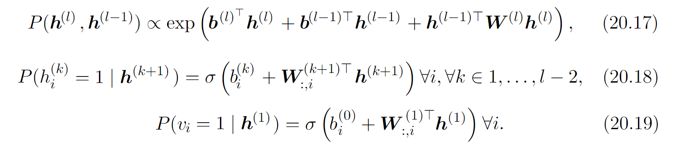
20.3 Deep Belief Networks
A DBN with l hidden layers contains l weight matrices: W ⁽¹⁾, . . . , W^{(l)} . It also contains l + 1 bias vectors: b ⁽⁰⁾, . . . , b^{(l)}, with b⁽⁰⁾ providing the biases for the visible layer. The probability distribution represented by the DBN is given by

Slide 30
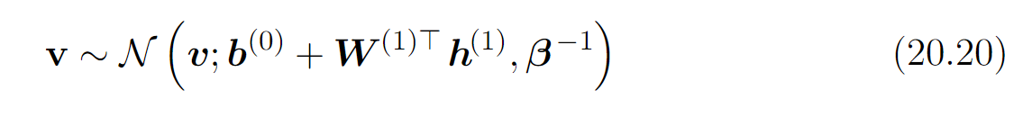
20.3 Deep Belief Networks
In the case of real-valued visible units, substitute
with β diagonal for tractability. Generalizations to other exponential family visible units are straightforward, at least in theory. A DBN with only one hidden layer is just an RBM.
To generate a sample from a DBN, we first run several steps of Gibbs sampling on the top two hidden layers. This stage is essentially drawing a sample from the RBM defined by the top two hidden layers. We can then use a single pass of ancestral sampling through the rest of the model to draw a sample from the visible units.

Slide 31
20.3 Deep Belief Networks
Deep belief networks incur many of the problems associated with both directed models and undirected models.
Inference in a deep belief network is intractable due to the explaining away effect within each directed layer, and due to the interaction between the two hidden layers that have undirected connections. Evaluating or maximizing the standard evidence lower bound on the log-likelihood is also intractable, because the evidence lower bound takes the expectation of cliques whose size is equal to the network width.

Slide 32
20.3 Deep Belief Networks
Evaluating or maximizing the log-likelihood requires not just confronting the problem of intractable inference to marginalize out the latent variables, but also the problem of an intractable partition function within the undirected model of the top two layers.
To train a deep belief network, one begins by training an RBM to maximize E_{v~pdata} log p(v) using contrastive divergence or stochastic maximum likelihood. The parameters of the RBM then define the parameters of the first layer of the DBN. Next, a second RBM is trained to approximately maximize
where p⁽¹⁾ is the probability distribution represented by the first RBM and p⁽²⁾ is the probability distribution represented by the second RBM.

Slide 33
20.3 Deep Belief Networks
In other words, the second RBM is trained to model the distribution defined by sampling the hidden units of the first RBM, when the first RBM is driven by the data. This procedure can be repeated indefinitely, to add as many layers to the DBN as desired, with each new RBM modeling the samples of the previous one. Each RBM defines another layer of the DBN. This procedure can be justified as increasing a variational lower bound on the log-likelihood of the data under the DBN (Hinton et al., 2006).
In most applications, no effort is made to jointly train the DBN after the greedy layer-wise procedure is complete. However, it is possible to perform generative fine-tuning using the wake-sleep algorithm.

Slide 34
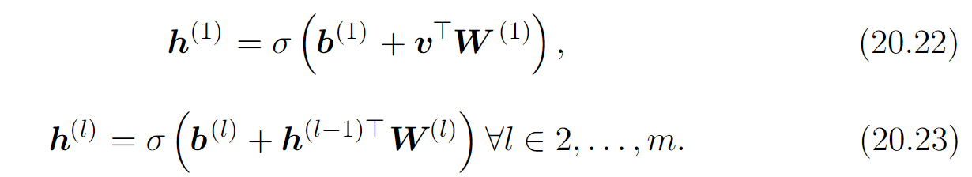
20.3 Deep Belief Networks
The trained DBN may be used directly as a generative model, but most of the interest in DBNs arose from their ability to improve classification models. We can take the weights from the DBN and use them to define an MLP:
After initializing this MLP with the weights and biases learned via generative training of the DBN, we may train the MLP to perform a classification task. This additional training of the MLP is an example of discriminative fine-tuning.

Slide 35
20.3 Deep Belief Networks
This specific choice of MLP is somewhat arbitrary, compared to many of the inference equations in Chapter 19 that are derived from first principles. This MLP is a heuristic choice that seems to work well in practice and is used consistently in the literature. Many approximate inference techniques are motivated by their ability to find a maximally tight variational lower bound on the log-likelihood under some set of constraints. One can construct a variational lower bound on the log-likelihood using the hidden unit expectations defined by the DBN’s MLP, but this is true of any probability distribution over the hidden units, and there is noreason to believe that this MLP provides a particularly tight bound. In particular, the MLP ignores many important interactions in the DBN graphical model.

Slide 36
20.3 Deep Belief Networks
The MLP propagates information upward from the visible units to the deepest hidden units, but does not propagate any information downward or sideways. The DBN graphical model has explaining away interactions between all of the hidden units within the same layer as well as top-down interactions between layers.
While the log-likelihood of a DBN is intractable, it may be approximated with AIS (Salakhutdinov and Murray, 2008). This permits evaluating its quality as a generative model.

Slide 37
20.3 Deep Belief Networks
The term “deep belief network” is commonly used incorrectly to refer to any kind of deep neural network, even networks without latent variable semantics. The term “deep belief network” should refer specifically to models with undirected connections in the deepest layer and directed connections pointing downward between all other pairs of consecutive layers.
The term “deep belief network” may also cause some confusion because the term “belief network” is sometimes used to refer to purely directed models, while deep belief networks contain an undirected layer. Deep belief networks also share the acronym DBN with dynamic Bayesian networks (Dean and Kanazawa, 1989), which are Bayesian networks for representing Markov chains.

Slide 38
Chapter 20 Deep Generative Models
20.4 Deep Boltzmann Machines
Acknowledge to: Guohua Yue, Xin Lin
Organizers: Guoqiang Zhong, Zhaoyang Niu
Machine Learning Research Group
Ocean University of China
Qingdao, China
https://github.com/AdolfKing/DeepLearningSlides

Slide 39
20.4 Deep Boltzmann Machines
A deep Boltzmann machine or DBM (Salakhutdinov and Hinton, 2009a) is another kind of deep, generative model. Unlike the deep belief network (DBN), it is an entirely undirected model. Unlike the RBM, the DBM has several layers of latent variables (RBMs have just one). But like the RBM, within each layer, each of the variables are mutually independent, conditioned on the variables in the neighboring layers. See Fig. 20.2 for the graph structure. Deep Boltzmann machines have been applied to a variety of tasks including document modeling (Srivastava et al., 2013).
Like RBMs and DBNs, DBMs typically contain only binary units—as we assume for simplicity of our presentation of the model—but it is straightforward to include real-valued visible units.

Slide 40
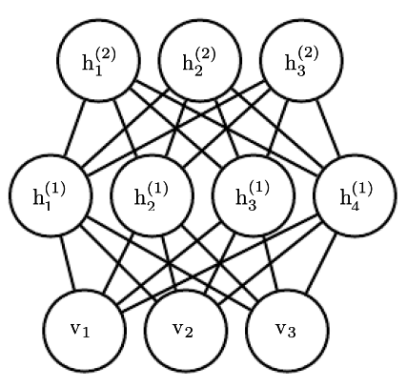
20.4 Deep Boltzmann Machines
Figure 20.2: The graphical model for a deep Boltzmann machine with one visible layer (bottom) and two hidden layers. Connections are only between units in neighboring layers. There are no intra-layer layer connections.

Slide 41
20.4 Deep Boltzmann Machines
A DBM is an energy-based model, meaning that the the joint probability distribution over the model variables is parametrized by an energy function E. In the case of a deep Boltzmann machine with one visible layer, v, and three hidden layers, h⁽¹⁾, h⁽²⁾ and h⁽³⁾, the joint probability is given by:
To simplify our presentation, we omit the bias parameters below. The DBM energy function is then defined as follows:

Slide 42
20.4 Deep Boltzmann Machines
In comparison to the RBM energy function (Eq. 20.5), the DBM energy function includes connections between the hidden units (latent variables) in the form of the weight matrices (W ⁽²⁾ and W ⁽³⁾). As we will see, these connections have significant consequences for both the model behavior as well as how we go about performing inference in the model.
In comparison to fully connected Boltzmann machines (with every unit connected to every other unit), the DBM offers some advantages that are similar to those offered by the RBM. Specifically, as illustrated in Fig. 20.3, the DBM layers can be organized into a bipartite graph, with odd layers on one side and even layers on the other. This immediately implies that when we condition on the variables in the even layer, the variables in the odd layers become conditionally independent.

Slide 43
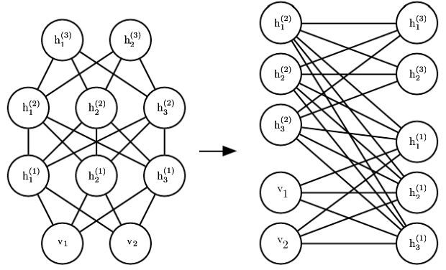
20.4 Deep Boltzmann Machines
Of course, when we condition on the variables in the odd layers, the variables in the even layers also become conditionally independent.
Figure 20.3: A deep Boltzmann machine, re-arranged to reveal its bipartite graph structure.

Slide 44
20.4 Deep Boltzmann Machines
The bipartite structure of the DBM means that we can apply the same equations we have previously used for the conditional distributions of an RBM to determine the conditional distributions in a DBM. The units within a layer are conditionally independent from each other given the values of the neighboring layers, so the distributions over binary variables can be fully described by the Bernoulli parameters giving the probability of each unit being active. In our example with two hidden layers, the activation probabilities are given by:

Slide 45
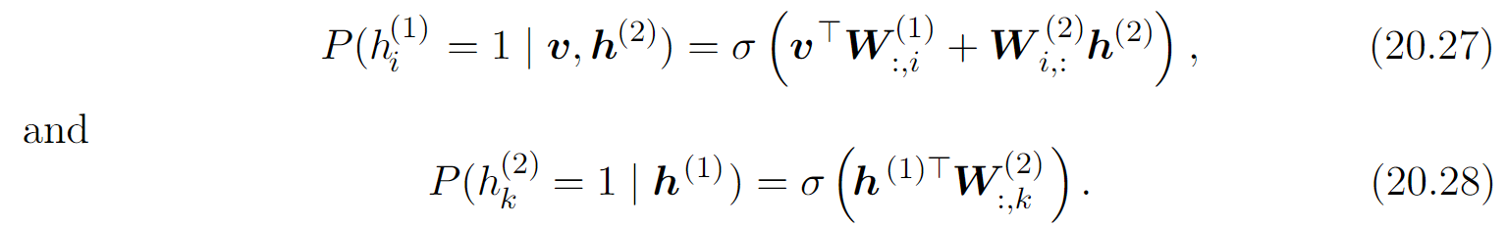
20.4 Deep Boltzmann Machines
The bipartite structure makes Gibbs sampling in a deep Boltzmann machine efficient. The naive approach to Gibbs sampling is to update only one variable at a time. RBMs allow all of the visible units to be updated in one block and all of the hidden units to be updated in a second block. One might naively assume that a DBM with l layers requires l+ 1 updates, with each iteration updating a block consisting of one layer of units. Instead, it is possible to update all of the units in only two iterations.

Slide 46
20.4 Deep Boltzmann Machines
Gibbs sampling can be divided into two blocks of updates, one including all even layers (including the visible layer) and the other including all odd layers. Due to the bipartite DBM connection pattern, given the even layers, the distribution over the odd layers is factorial and thus can be sampled simultaneously and independently as a block. Likewise, given the odd layers, the even layers can be sampled simultaneously and independently as a block. Efficient sampling is especially important for training with the stochastic maximum likelihood algorithm.

Slide 47
20.4.1 Interesting Properties
Deep Boltzmann machines have many interesting properties.
DBMs were developed after DBNs. Compared to DBNs, the posterior distribution P(h | v) is simpler for DBMs. Somewhat counterintuitively, the simplicity of this posterior distribution allows richer approximations of the posterior. In the case of the DBN, we perform classification using a heuristically motivated approximate inference procedure, in which we guess that a reasonable value for the mean field expectation of the hidden units can be provided by an upward pass through the network in an MLP that uses sigmoid activation functions and the same weights as the original DBN. Any distribution Q(h) may be used to obtain a variational lower bound on the log-likelihood. This heuristic procedure therefore allows us to obtain such a bound.

Slide 48
20.4.1 Interesting Properties
However, the bound is not explicitly optimized in any way, so the bound may be far from tight. In particular, the heuristic estimate of Q ignores interactions between hidden units within the same layer as well as the top-down feedback influence of hidden units in deeper layers on hidden units that are closer to the input. Because the heuristic MLP-based inference procedure in the DBN is not able to account for these interactions, the resulting Q is presumably far from optimal. In DBMs, all of the hidden units within a layer are conditionally independent given the other layers. This lack of intra-layer interaction makes it possible to use fixed point equations to actually optimize the variational lower bound and find the true optimal mean field expectations (to within some numerical tolerance).

Slide 49
20.4.1 Interesting Properties
The use of proper mean field allows the approximate inference procedure for DBMs to capture the influence of top-down feedback interactions. This makes DBMs interesting from the point of view of neuroscience, because the human brain is known to use many top-down feedback connections. Because of this property, DBMs have been used as computational models of real neuroscientific phenomena (Series et al., 2010; Reichert et al., 2011).

Slide 50
20.4.1 Interesting Properties
One unfortunate property of DBMs is that sampling from them is relatively difficult. DBNs only need to use MCMC sampling in their top pair of layers. The other layers are used only at the end of the sampling process, in one efficient ancestral sampling pass. To generate a sample from a DBM, it is necessary to use MCMC across all layers, with every layer of the model participating in every Markov chain transition.

Slide 51
20.4.2 DBM Mean Field Inference
The conditional distribution over one DBM layer given the neighboring layers is factorial. In the example of the DBM with two hidden layers, these distributions are P (v | h ⁽¹⁾), P (h⁽¹⁾ | v, h ⁽²⁾) and P(h⁽²⁾ | h⁽¹⁾ ). The distribution over all hidden layers generally does not factorize because of interactions between layers. In the example with two hidden layers, P(h⁽¹⁾, h⁽²⁾ | v) does not factorize due due to the interaction weights W ⁽²⁾ between h ⁽¹⁾ and h⁽²⁾ which render these variables mutually dependent.

Slide 52
20.4.2 DBM Mean Field Inference
As was the case with the DBN, we are left to seek out methods to approximate the DBM posterior distribution. However, unlike the DBN, the DBM posterior distribution over their hidden units—while complicated—is easy to approximate with a variational approximation (as discussed in Sec. 19.4), specifically a mean field approximation. The mean field approximation is a simple form of variational inference, where we restrict the approximating distribution to fully factorial distributions. In the context of DBMs, the mean field equations capture the bidirectional interactions between layers. In this section we derive the iterative approximate inference procedure originally introduced in Salakhutdinov and Hinton (2009a).

Slide 53
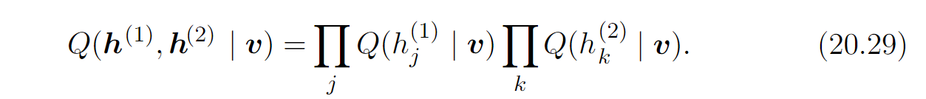
20.4.2 DBM Mean Field Inference
In variational approximations to inference, we approach the task of approximating a particular target distribution—in our case, the posterior distribution over the hidden units given the visible units—by some reasonably simple family of distributions. In the case of the mean field approximation, the approximating family is the set of distributions where the hidden units are conditionally independent.
We now develop the mean field approach for the example with two hidden layers. Let Q(h⁽¹⁾, h⁽²⁾ | v) be the approximation of P(h⁽¹⁾, h⁽²⁾ | v) . The mean field assumption implies that

Slide 54
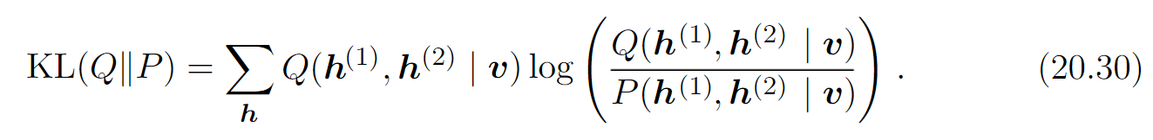
20.4.2 DBM Mean Field Inference
The mean field approximation attempts to find a member of this family of distributions that best fits the true posterior P (h⁽¹⁾, h⁽²⁾ | v). Importantly, the inference process must be run again to find a different distribution Q every time we use a new value of v.
One can conceive of many ways of measuring how well Q(h | v) fits P(h | v).
The mean field approach is to minimize

Slide 55
20.4.2 DBM Mean Field Inference
In general, we do not have to provide a parametric form of the approximating distribution beyond enforcing the independence assumptions. The variational approximation procedure is generally able to recover a functional form of the approximate distribution. However, in the case of a mean field assumption on binary hidden units (the case we are developing here) there is no loss of generality resulting from fixing a parametrization of the model in advance.

Slide 56
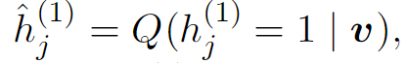
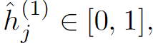
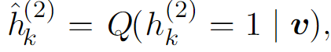
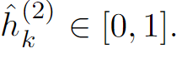
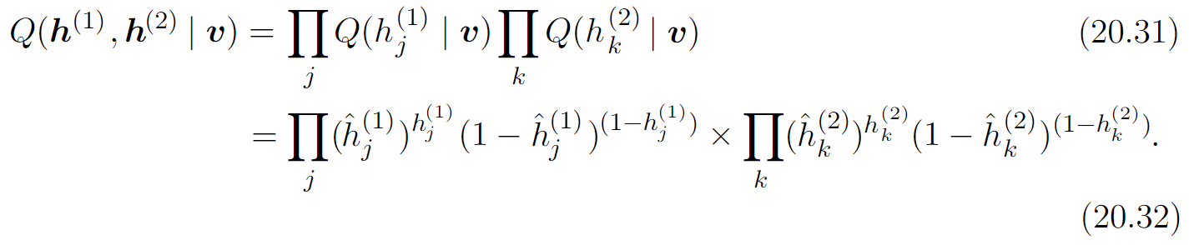
20.4.2 DBM Mean Field Inference
We parametrize Q as a product of Bernoulli distributions, that is we associate the probability of each element of h⁽¹⁾ with a parameter. Specifically, for each j,
, where and for each k ,
where Thus we have the following approximation to the posterior:

Slide 57
20.4.2 DBM Mean Field Inference
Of course, for DBMs with more layers the approximate posterior parametrization can be extended in the obvious way, exploiting the bipartite structure of the graph to update all of the even layers simultaneously and then to update all of the odd layers simultaneously, following the same schedule as Gibbs sampling.
Now that we have specified our family of approximating distributions Q, it remains to specify a procedure for choosing the member of this family that best fits P . The most straightforward way to do this is to use the mean field equations specified by Eq. 19.56.

Slide 58
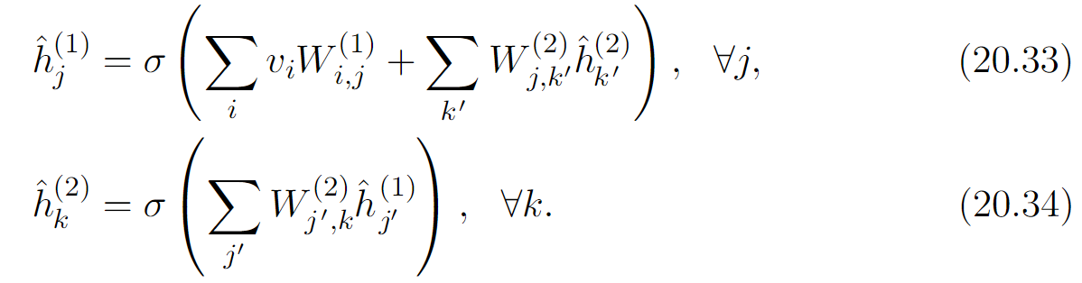
20.4.2 DBM Mean Field Inference
These equations were derived by solving for where the derivatives of the variational lower bound are zero. They describe in an abstract manner how to optimize the variational lower bound for any model, simply by taking expectations with respect to Q.
Applying these general equations, we obtain the update rules (again, ignoring
bias terms):

Slide 59
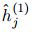
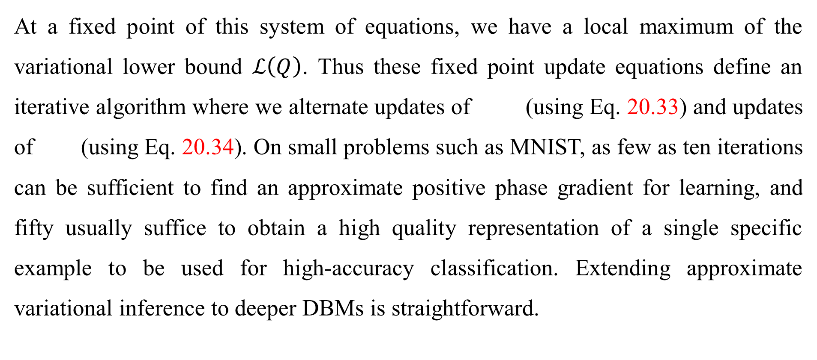
20.4.2 DBM Mean Field Inference
At a fixed point of this system of equations, we have a local maximum of the variational lower bound $ℒ\left(Q\right)$. Thus these fixed point update equations define an iterative algorithm where we alternate updates of (using Eq. 20.33) and updates of (using Eq. 20.34). On small problems such as MNIST, as few as ten iterations can be sufficient to find an approximate positive phase gradient for learning, and fifty usually suffice to obtain a high quality representation of a single specific example to be used for high-accuracy classification. Extending approximate variational inference to deeper DBMs is straightforward.

Slide 60
20.4.3 DBM Parameter Learning
Learning in the DBM must confront both the challenge of an intractable partition function, using the techniques from Chapter 18, and the challenge of an intractable posterior distribution, using the techniques from Chapter 19.
As described in Sec. 20.4.2, variational inference allows the construction of a
distribution Q(h | v) that approximates the intractable P(h | v). Learning then proceeds by maximizing L (v, Q, θ), the variational lower bound on the intractable
log-likelihood, log P(v; θ).

Slide 61
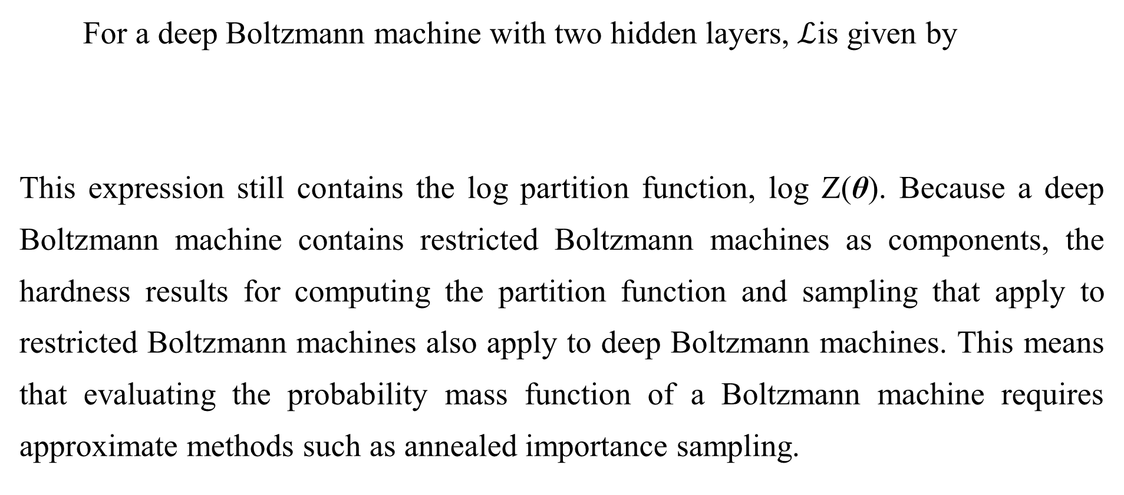
20.4.3 DBM Parameter Learning
For a deep Boltzmann machine with two hidden layers, $ℒ$is given by
This expression still contains the log partition function, log Z(θ). Because a deep Boltzmann machine contains restricted Boltzmann machines as components, the hardness results for computing the partition function and sampling that apply to restricted Boltzmann machines also apply to deep Boltzmann machines. This means that evaluating the probability mass function of a Boltzmann machine requires approximate methods such as annealed importance sampling.

Slide 62
20.4.3 DBM Parameter Learning
Likewise, training the model requires approximations to the gradient of the log partition function. See Chapter 18 for a general description of these methods. DBMs are typically trained using stochastic maximum likelihood. Many of the other techniques described in Chapter 18 are not applicable. Techniques such as pseudolikelihood require the ability to evaluate the unnormalized probabilities, rather than merely obtain a variational lower bound on them.

Slide 63
20.4.3 DBM Parameter Learning
Contrastive divergence is slow for deep Boltzmann machines because they do not allow efficient sampling of the hidden units given the visible units—instead, contrastive divergence would require burning in a Markov chain every time a new negative phase sample is needed.
The non-variational version of stochastic maximum likelihood algorithm was discussed earlier, in Sec. 18.2. Variational stochastic maximum likelihood as applied to the DBM is given in Algorithm 20.1. Recall that we describe a simplified varient of the DBM that lacks bias parameters; including them is trivial.

Slide 64
20.4.4 Layer-Wise Pretraining
Algorithm 20.1 The variational stochastic maximum likelihood algorithm for training a DBM with two hidden layers.
Set ε, the step size, to a small positive number
Set k , the number of Gibbs steps, high enough to allow a Markov chain of p(v, h⁽¹⁾, h⁽²⁾; θ+ε∆_{θ}) to burn in, starting from samples from p(v, h⁽¹⁾, h⁽²⁾; θ).
Initialize three matrices, each with m columns set to random values (e.g., from Bernoulli distributions, possibly with marginals matched to the model’s marginals).
while not converged (learning loop) do
Sample a minibatch of m examples from the training data and arrange them as
the rows of a design matrix V.

Slide 65
20.4.4 Layer-Wise Pretraining
Algorithm 20.1 The variational stochastic maximum likelihood algorithm for training a DBM with two hidden layers.
Initialize matrices , possibly to the model’s marginals.
while not converged (mean field inference loop) do
end while

Slide 66
20.4.4 Layer-Wise Pretraining
Algorithm 20.1 The variational stochastic maximum likelihood algorithm for training a DBM with two hidden layers.
for l = 1 to k (Gibbs sampling) do
Gibbs block 1:
Gibbs block 2:
end for

Slide 67
20.4.4 Layer-Wise Pretraining
Algorithm 20.1 The variational stochastic maximum likelihood algorithm for training a DBM with two hidden layers.
(this is a cartoon illustration, in practice use a more
effective algorithm, such as momentum with a decaying learning rate)
end while

Slide 68
20.4.4 Layer-Wise Pretraining
Unfortunately, training a DBM using stochastic maximum likelihood (as described above) from a random initialization usually results in failure. In some cases, the model fails to learn to represent the distribution adequately. In other cases, the DBM may represent the distribution well, but with no higher likelihood than could be obtained with just an RBM. A DBM with very small weights in all but the first layer represents approximately the same distribution as an RBM.

Slide 69
20.4.4 Layer-Wise Pretraining
Various techniques that permit joint training have been developed and are described in Sec. 20.4.5. However, the original and most popular method for overcoming the joint training problem of DBMs is greedy layer-wise pretraining. In this method, each layer of the DBM is trained in isolation as an RBM. The first layer is trained to model the input data. Each subsequent RBM is trained to model samples from the previous RBM’s posterior distribution. After all of theRBMs have been trained in this way, they can be combined to form a DBM. The DBM may then be trained with PCD. Typically PCD training will make only a small change in the model’s parameters and its performance as measured by the log-likelihood it assigns to the data, or its ability to classify inputs. See Fig. 20.4 for an illustration of the training procedure.

Slide 70
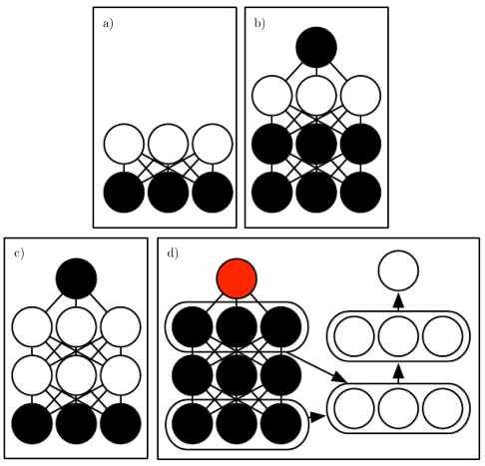
20.4.4 Layer-Wise Pretraining
Figure 20.4: The deep Boltzmann machine training procedure used to classify the MNIST dataset (Salakhutdinov and Hinton, 2009a; Srivastava et al., 2014). (a) Train an RBM by using CD to approximately maximize logP(v). (b) Train a second RBM that models h⁽¹⁾ and target class y by using CD-k to approximately maximize logP(h⁽¹⁾ ,y) where h⁽¹⁾ is drawn from the first RBM’s posterior conditioned on the data. Increase k from 1 to 20 during learning. (c) Combine the two RBMs into a DBM. Train it to approximately maximize logP(v,y) using stochastic maximum likelihood with k = 5. (d) Delete y from the model. Define a new set of features h⁽¹⁾ and h⁽²⁾ that are obtained by running mean field inference in the model lacking y . Use these features as input to an MLP whose structure is the same as an additional pass of mean field, with an additional output layer for the estimate of y . Initialize the MLP’s weights to be the same as the DBM’s weights. Train the MLP to approximately maximize logP(y|v) using stochastic gradient descent and dropout. Figure reprinted from (Goodfellow et al., 2013b).

Slide 71
20.4.4 Layer-Wise Pretraining
This greedy layer-wise training procedure is not just coordinate ascent. It bears some passing resemblance to coordinate ascent because we optimize one subset of the parameters at each step. However, in the case of the greedy layer-wise training procedure, we actually use a different objective function at each step.
Greedy layer-wise pretraining of a DBM differs from greedy layer-wise pre-training of a DBN. The parameters of each individual RBM may be copied to the corresponding DBN directly. In the case of the DBM, the RBM parameters must be modified before inclusion in the DBM. A layer in the middle of the stack of RBMs is trained with only bottom-up input, but after the stack is combined to form the DBM, the layer will have both bottom-up and top-down input.

Slide 72
20.4.4 Layer-Wise Pretraining
To account for this effect, Salakhutdinov and Hinton (2009a) advocate dividing the weights of all but the top and bottom RBM in half before inserting them into the DBM. Additionally, the bottom RBM must be trained using two “copies” of each visible unit and the weights tied to be equal between the two copies. This means that the weights are effectively doubled during the upward pass. Similarly, the top RBM should be trained with two copies of the topmost layer.

Slide 73
20.4.4 Layer-Wise Pretraining
Obtaining the state of the art results with the deep Boltzmann machine requires a modification of the standard SML algorithm, which is to use a small amount of mean field during the negative phase of the joint PCD training step (Salakhutdinov and Hinton, 2009a). Specifically, the expectation of the energy gradient should be computed with respect to the mean field distribution in which all of the units are independent from each other. The parameters of this mean field distribution should be obtained by running the mean field fixed point equations for just one step. See Goodfellow et al. (2013b) for a comparison of the performance of centered DBMs with and without the use of partial mean field in the negative phase.

Slide 74
20.4.5 Jointly Training Deep Boltzmann Machines
Classic DBMs require greedy unsupervised pretraining, and to perform classification well, require a separate MLP-based classifier on top of the hidden features they extract. This has some undesirable properties. It is hard to track performance during training because we cannot evaluate properties of the full DBM while training the first RBM. Thus, it is hard to tell how well our hyperparameters are working until quite late in the training process. Software implementations of DBMs need to have many different components for CD training of individual RBMs, PCD training of the full DBM, and training based on back-propagation through the MLP. Finally, the MLP on top of the Boltzmann machine loses many of the advantages of the Boltzmann machine probabilistic model, such as being able to perform inference when some input values are missing.

Slide 75
20.4.5 Jointly Training Deep Boltzmann Machines
There are two main ways to resolve the joint training problem of the deep Boltzmann machine. The first is the centered deep Boltzmann machine (Montavon and Muller, 2012), which reparametrizes the model in order to make the Hessian of the cost function better-conditioned at the beginning of the learning process. This yields a model that can be trained without a greedy layer-wise pretraining stage. The resulting model obtains excellent test set log-likelihood and produces high quality samples. Unfortunately, it remains unable to compete with appropriately regularized MLPs as a classifier. The second way to jointly train a deep Boltzmann machine is to use a multi-prediction deep Boltzmann machine (Goodfellow et al., 2013b).

Slide 76
20.4.5 Jointly Training Deep Boltzmann Machines
This model uses an alternative training criterion that allows the use of the back-propagation algorithm in order to avoid the problems with MCMC estimates of the gradient. Unfortunately, the new criterion does not lead to good likelihood or samples, but, compared to the MCMC approach, it does lead to superior classification performance and ability to reason well about missing inputs.
The centering trick for the Boltzmann machine is easiest to describe if we return to the general view of a Boltzmann machine as consisting of a set of units x with a weight matrix U and biases b . Recall from Eq. 20.2 that he energy function is given by

Slide 77
20.4.5 Jointly Training Deep Boltzmann Machines
Using different sparsity patterns in the weight matrix U, we can implement structures of Boltzmann machines, such as RBMs, or DBMs with different numbers of layers. This is accomplished by partitioning x into visible and hidden units and zeroing out elements of U for units that do not interact. The centered Boltzmann machine introduces a vector µ that is subtracted from all of the states:

Slide 78
20.4.5 Jointly Training Deep Boltzmann Machines
Typically µ is a hyperparameter fixed at the beginning of training. It is usually chosen to make sure that x − µ ≈ 0 when the model is initialized. This reparametrization does not change the set of probability distributions that the model can represent, but it does change the dynamics of stochastic gradient descent applied to the likelihood. Specifically, in many cases, this reparametrization results in a Hessian matrix that is better conditioned. Melchior et al. (2013) experimentally confirmed that the conditioning of the Hessian matrix improves, and observed that the centering trick is equivalent to another Boltzmann machine learning technique, the enhanced gradient (Cho et al., 2011). The improved conditioning of the Hessian matrix allows learning to succeed, even in difficult cases like training a deep Boltzmann machine with multiple layers.

Slide 79
20.4.5 Jointly Training Deep Boltzmann Machines
The other approach to jointly training deep Boltzmann machines is the multi-prediction deep Boltzmann machine (MP-DBM) which works by viewing the mean field equations as defining a family of recurrent networks for approximately solving every possible inference problem (Goodfellow et al., 2013b). Rather than training the model to maximize the likelihood, the model is trained to make each recurrent network obtain an accurate answer to the corresponding inference problem. The training process is illustrated in Fig. 20.5. It consists of randomly sampling a training example, randomly sampling a subset of inputs to the inference network, and then training the inference network to predict the values of the remaining units.

Slide 80
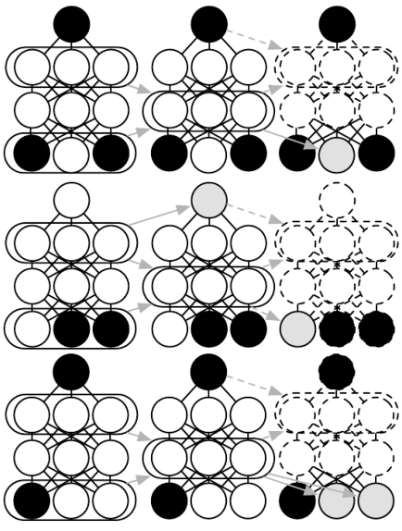
20.4.5 Jointly Training Deep Boltzmann Machines
Figure 20.5: An illustration of the multi-prediction training process for a deep Boltzmann machine. Each row indicates a different example within a minibatch for the same training step. Each column represents a time step within the mean field inference process. For each example, we sample a subset of the data variables to serve as inputs to the inference process. These variables are shaded black to indicate conditioning. We then run the mean field inference process, with arrows indicating which variables influence which other variables in the process. In practical applications, we unroll mean field for several steps. In this illustration, we unroll for only two steps. Dashed arrows indicate how the process could be unrolled for more steps. The data variables that were not used as inputs to the inference process become targets, shaded in gray. We can view the inference process for each example as a recurrent network. We use gradient descent and back-propagation to train these recurrent networks to produce the correct targets given their inputs. This trains the mean field process for the MP-DBM to produce accurate estimates. Figure adapted from Goodfellow et al. (2013b).

Slide 81
20.4.5 Jointly Training Deep Boltzmann Machines
This general principle of back-propagating through the computational graph for approximate inference has been applied to other models (Stoyanov et al., 2011; Brakel et al., 2013). In these models and in the MP-DBM, the final loss is not the lower bound on the likelihood. Instead, the final loss is typically based on the approximate conditional distribution that the approximate inference network imposes over the missing values. This means that the training of these models is somewhat heuristically motivated. If we inspect the p(v) represented by the Boltzmann machine learned by the MP-DBM, it tends to be somewhat defective, in the sense that Gibbs sampling yields poor samples.

Slide 82
20.4.5 Jointly Training Deep Boltzmann Machines
Back-propagation through the inference graph has two main advantages. First, it trains the model as it is really used—with approximate inference. This means that approximate inference, for example, to fill in missing inputs, or to perform classification despite the presence of missing inputs, is more accurate in the MP-DBM than in the original DBM. The original DBM does not make an accurate classifier on its own; the best classification results with the original DBM were based on training a separate classifier to use features extracted by the DBM, rather than by using inference in the DBM to compute the distribution over the class labels. Mean field inference in the MP-DBM performs well as a classifier without special modifications.

Slide 83
20.4.5 Jointly Training Deep Boltzmann Machines
The other advantage of back-propagating through approximate inference is that back-propagation computes the exact gradient of the loss. This is better for optimization than the approximate gradients of SML training, which suffer from both bias and variance. This probably explains why MP-DBMs may be trained jointly while DBMs require a greedy layer-wise pretraining. The disadvantage of back-propagating through the approximate inference graph is that it does not provide a way to optimize the log-likelihood, but rather a heuristic approximation of the generalized pseudolikelihood.
The MP-DBM inspired the NADE-k (Raiko et al., 2014) extension to the NADE framework, which is described in Sec. 20.10.10.

Slide 84
20.4.5 Jointly Training Deep Boltzmann Machines
The MP-DBM has some connections to dropout. Dropout shares the same parameters among many different computational graphs, with the difference between each graph being whether it includes or excludes each unit. The MP-DBM also shares parameters across many computational graphs. In the case of the MP-DBM, the difference between the graphs is whether each input unit is observed or not. When a unit is not observed, the MP-DBM does not delete it entirely as in the case of dropout. Instead, the MP-DBM treats it as a latent variable to be inferred. One could imagine applying dropout to the MP-DBM by additionally removing some units rather than making them latent.

Slide 85
Chapter 20 Deep Generative Models
20.5 Boltzmann Machines for Real-Valued Data
Acknowledge to: Wencong Jiao
Organizers: Guoqiang Zhong, Wencong Jiao
Machine Learning Research Group
Ocean University of China
Qingdao, China
https://github.com/AdolfKing/DeepLearningSlides

Slide 86
20.5 Boltzmann Machines for Real-Valued Data
While Boltzmann machines were originally developed for use with binary data, many applications such as image and audio modeling seem to require the ability to represent probability distributions over real values. In some cases, it is possible to treat real-valued data in the interval [0, 1] as representing the expectation of a binary variable. For example, Hinton (2000) treats grayscale images in the training set as defining [0,1] probability values. Each pixel defines the probability of a binary value being 1, and the binary pixels are all sampled independently from each other. This is a common procedure for evaluating binary models on grayscale image datasets. However, it is not a particularly theoretically satisfying approach, and binary images sampled independently in this way have a noisy appearance. In this section, we present Boltzmann machines that define a probability density over real-valued data.

Slide 87
20.5.1 Gaussian-Bernoulli RBMs
Restricted Boltzmann machines may be developed for many exponential family conditional distributions (Welling et al., 2005). Of these, the most common is the RBM with binary hidden units and real-valued visible units, with the conditional distribution over the visible units being a Gaussian distribution whose mean is a function of the hidden units.
There are many ways of parametrizing Gaussian-Bernoulli RBMs. First, we may choose whether to use a covariance matrix or a precision matrix for the Gaussian distribution. Here we present the precision formulation. The modification to obtain the covariance formulation is straightforward. We wish to have the conditional distribution

Slide 88
20.5.1 Gaussian-Bernoulli RBMs
We can find the terms we need to add to the energy function by expanding the unnormalized log conditional distribution:
Here f encapsulates all the terms that are a function only of the parameters and not the random variables in the model. We can discard f because its only role is to normalize the distribution, and the partition zfunction of whatever energy function we choose will carry out that role.

Slide 89
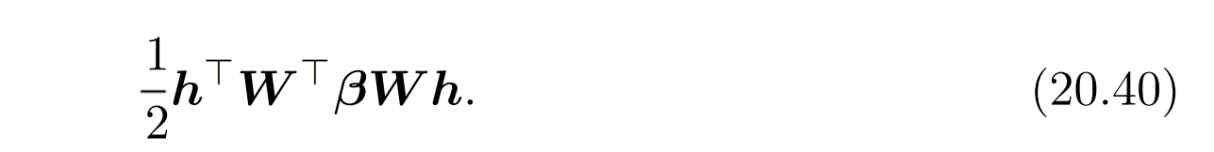
20.5.1 Gaussian-Bernoulli RBMs
If we include all of the terms (with their sign flipped) involving v from Eq. 20.39 in our energy function and do not add any other terms involving v, then our energy function will represent the desired conditional p(v | h).
We have some freedom regarding the other conditional distribution, p(h | v). Note that Eq. 20.39 contains a term

Slide 90
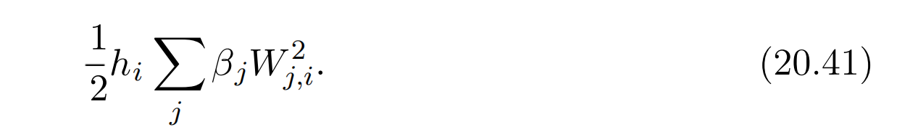
20.5.1 Gaussian-Bernoulli RBMs
This term cannot be included in its entirety because it includes h_{i}h_{j} terms. These correspond to edges between the hidden units. If we included these terms, we would have a linear factor model instead of a restricted Boltzmann machine. When designing our Boltzmann machine, we simply omit these h_{i}h_{j} cross terms. Omitting them does not change the conditional p(v | h) so Eq. 20.39 is still respected. However, we still have a choice about whether to include the terms involving only a single h_{i}. If we assume a diagonal precision matrix, we find that for each hidden unit h_{i} we have a term

Slide 91
20.5.1 Gaussian-Bernoulli RBMs
In the above, we used the fact that h²_{i} = h_{i} because h_{i} ∈ {0, 1}. If we include this term (with its sign flipped) in the energy function, then it will naturally bias h_{i} to be turned off when the weights for that unit are large and connected to visible units with high precision. The choice of whether or not to include this bias term does not affect the family of distributions the model can represent (assuming that we include bias parameters for the hidden units) but it does affect the learning dynamics of the model. Including the term may help the hidden unit activations remain reasonable even when the weights rapidly increase in magnitude.

Slide 92
20.5.1 Gaussian-Bernoulli RBMs
One way to define the energy function on a Gaussian-Bernoulli RBM is thus
but we may also add extra terms or parametrize the energy in terms of the variance rather than precision if we choose.

Slide 93
20.5.1 Gaussian-Bernoulli RBMs
In this derivation, we have not included a bias term on the visible units, but one could easily be added. One final source of variability in the parametrization of a Gaussian-Bernoulli RBM is the choice of how to treat the precision matrix. It may either be fixed to a constant (perhaps estimated based on the marginal precision of the data) or learned. It may also be a scalar times the identity matrix, or it may be a diagonal matrix. Typically we do not allow the precision matrix to be non-diagonal in this context, because some operations would then require inverting the matrix. In the sections ahead, we will see that other forms of Boltzmann machines permit modeling the covariance structure, using various techniques to avoid inverting the precision matrix.

Slide 94
20.5.2 Undirected Models of Conditional Covariance
While the Gaussian RBM has been the canonical energy model for real-valued data, Ranzato et al. (2010a) argue that the Gaussian RBM inductive bias is not well suited to the statistical variations present in some types of real-valued data, especially natural images. The problem is that much of the information content present in natural images is embedded in the covariance between pixels rather than in the raw pixel values. In other words, it is the relationships between pixels and not their absolute values where most of the useful information in images resides. Since the Gaussian RBM only models the conditional mean of the input given the hidden units, it cannot capture conditional covariance information. In response to these criticisms, alternative models have been proposed that attempt to better account for the covariance of real-valued data. These models include the mean and covariance RBM (mcRBM), the mean-product of t distribution (mPoT) model and the spike and slab RBM (ssRBM).

Slide 95
20.5.2 Undirected Models of Conditional Covariance
Mean and Covariance RBM The mcRBM uses its hidden units to indepen- dently encode the conditional mean and covariance of all observed units. The mcRBM hidden layer is divided into two groups of units: mean units and covariance units. The group that models the conditional mean is simply a Gaussian RBM. The other half is a covariance RBM (Ranzato et al., 2010a), also called a cRBM, whose components model the conditional covariance structure, as described below.
Specifically, with binary mean units h^{(m)} and binary covariance units h^{(c)}, the mcRBM model is defined as the combination of two energy functions:

Slide 96
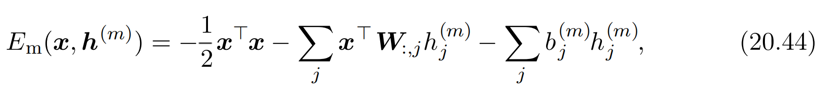
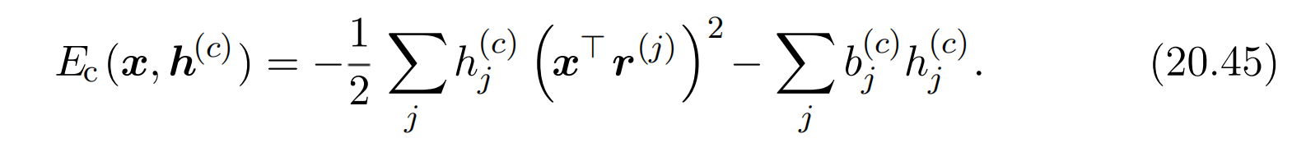
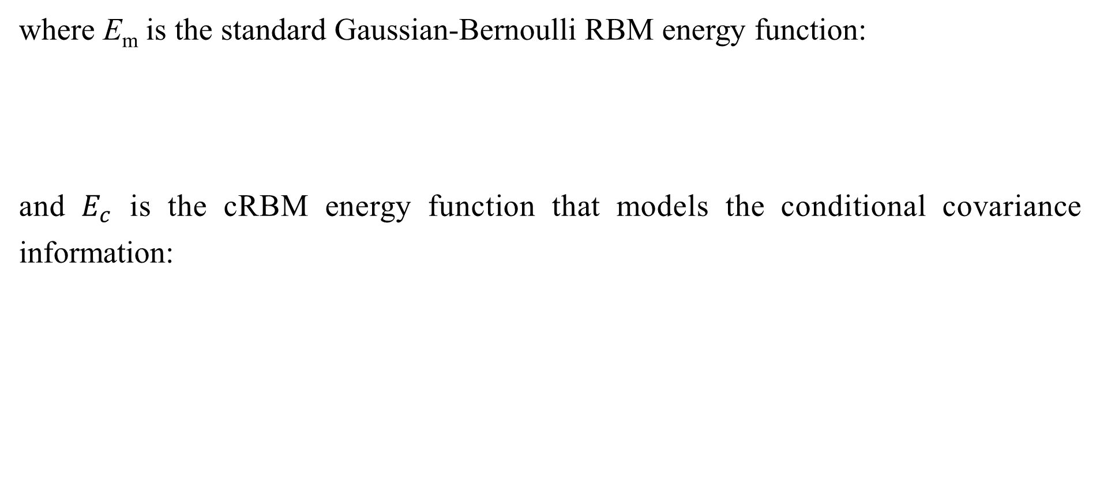
20.5.2 Undirected Models of Conditional Covariance
where E_{m} is the standard Gaussian-Bernoulli RBM energy function:
and $E_{c}$ is the cRBM energy function that models the conditional covariance information:

Slide 97
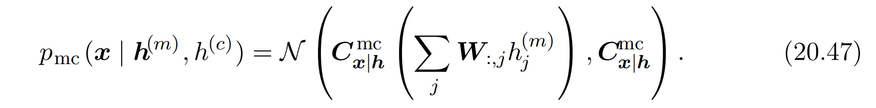
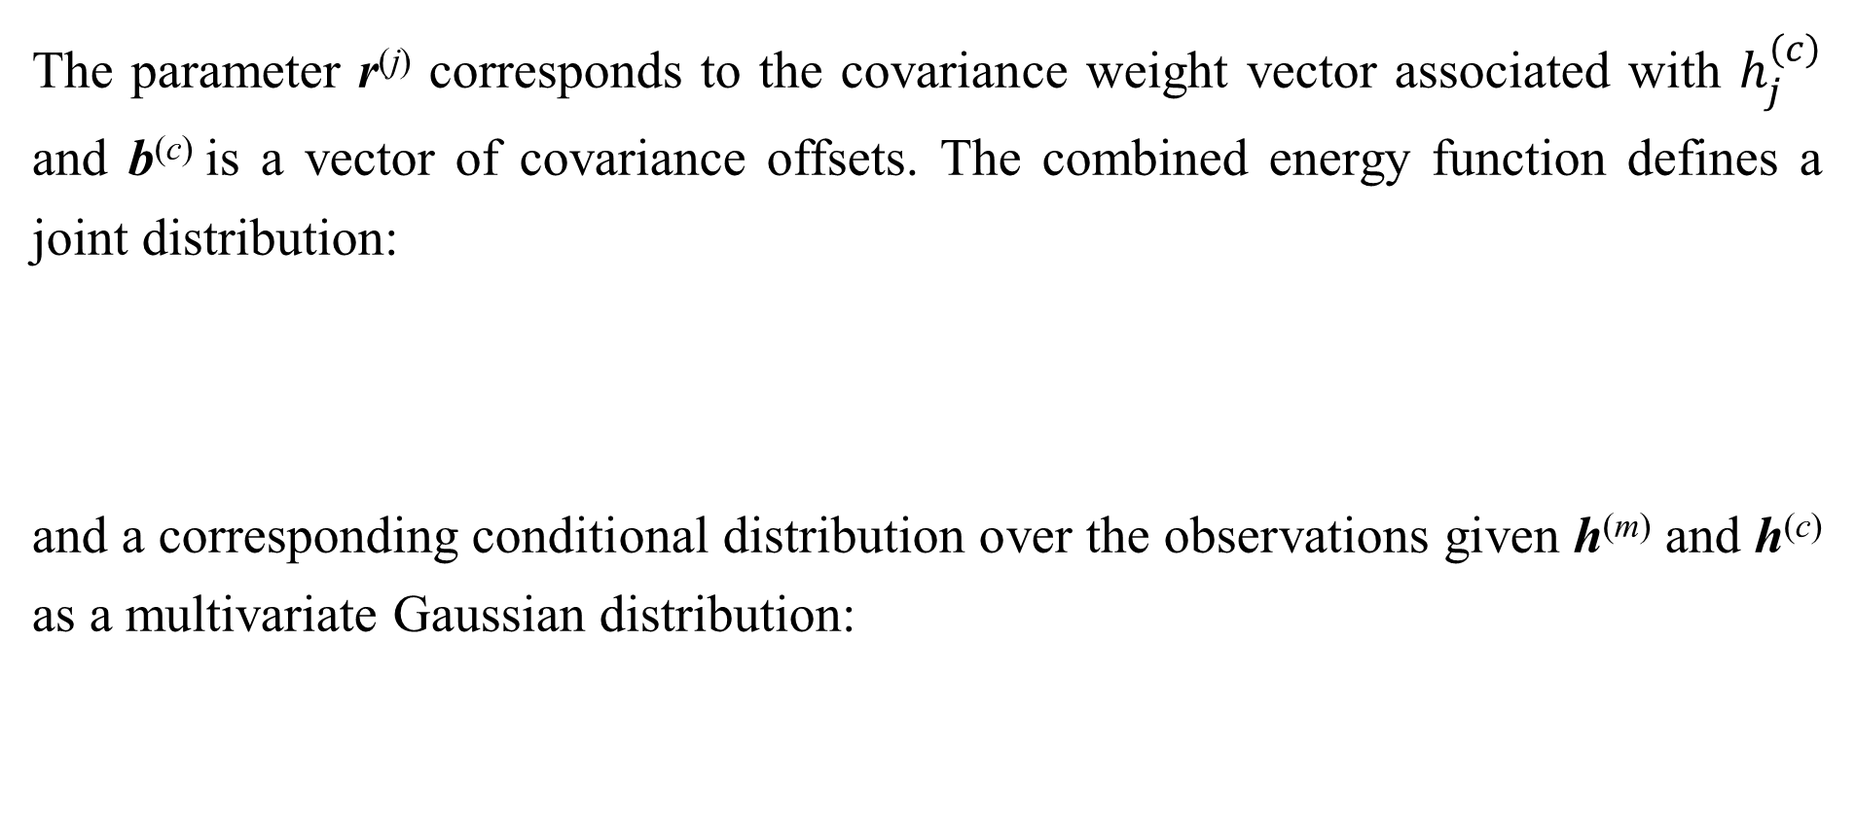
20.5.2 Undirected Models of Conditional Covariance
The parameter r^{(j)} corresponds to the covariance weight vector associated with $h_{j}^{\left(c\right)}$ and b^{(c)} is a vector of covariance offsets. The combined energy function defines a joint distribution:
and a corresponding conditional distribution over the observations given h^{(m)} and h^{(c)} as a multivariate Gaussian distribution:

Slide 98
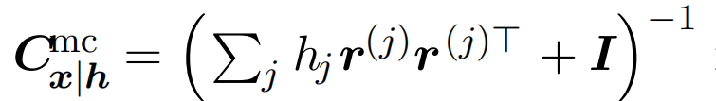
20.5.2 Undirected Models of Conditional Covariance
Note that the covariance matrix is non-diagonal and that W is the weight matrix associated with the Gaussian RBM modeling the conditional means. It is difficult to train the mcRBM via contrastive divergence or persistent contrastive divergence because of its non-diagonal conditional covariance structure. CD and PCD require sampling from the joint distribution of x, h^{(m)} , h^{(c)} which, in a standard RBM, is accomplished by Gibbs sampling over the conditionals. However, in the mcRBM, sampling from p_{mc}(x | h^{(m)} , h^{(c)}) requires computing (C^{mc})⁻¹ at every iteration of learning. This can be an impractical computational burden for larger observations. Ranzato and Hinton (2010) avoid direct sampling from the conditional p_{mc}(x | h^{(m)} , h^{(c)}) by sampling directly from the marginal p(x) using Hamiltonian (hybrid) Monte Carlo (Neal, 1993) on the mcRBM free energy.

Slide 99
20.5.2 Undirected Models of Conditional Covariance
Mean-Product of Student's t-distributions The mean-product of Student‘s t-distribution (mPoT) model (Ranzato et al., 2010b) extends the PoT model (Welling et al., 2003a) in a manner similar to how the mcRBM extends the cRBM. This is achieved by including nonzero Gaussian means by the addition of Gaussian RBM-like hidden units. Like the mcRBM, the PoT conditional distribution over the observation is a multivariate Gaussian (with non-diagonal covariance) distribution; however, unlike the mcRBM, the complementary conditional distribution over the hidden variables is given by conditionally independent Gamma distributions. The Gamma distribution G (k, θ) is a probability distribution over positive real numbers, with mean kθ. It is not necessary to have a more detailed understanding of the Gamma distribution to understand the basic ideas underlying the mPoT model.

Slide 100
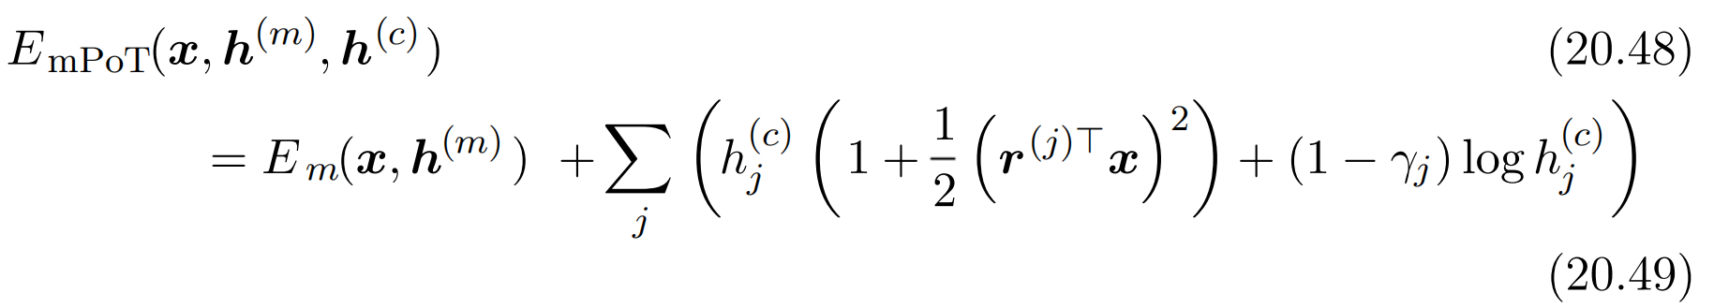
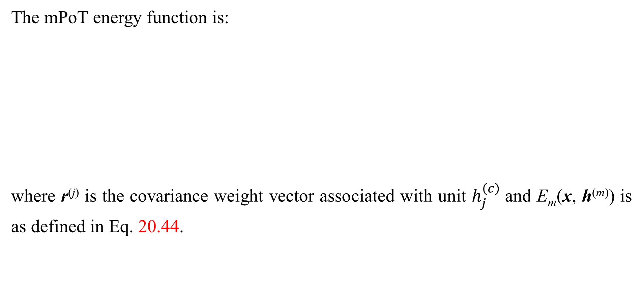
20.5.2 Undirected Models of Conditional Covariance
The mPoT energy function is:
where r^{(j)} is the covariance weight vector associated with unit $h_{j}^{\left(c\right)}$and E_{m}(x, h^{(m)}) is as defined in Eq. 20.44.

Slide 101
20.5.2 Undirected Models of Conditional Covariance
Just as with the mcRBM, the mPoT model energy function specifies a mul- tivariate Gaussian, with a conditional distribution over x that has non-diagonal covariance. The covariance units h^{(c)} are conditionally Gamma-distributed::
Learning in the mPoT model—again, like the mcRBM—is complicated by the in- ability to sample from the non-diagonal Gaussian conditional p_{mPoT}(x | h^{(m)} , h^{(c)}) , so Ranzato et al. (2010b) also advocate direct sampling of p(x) via Hamiltonian (hybrid) Monte Carlo.

Slide 102
20.5.2 Undirected Models of Conditional Covariance
Spike and Slab Restricted Boltzmann Machines Spike and slab restricted Boltzmann machines (Courville et al., 2011) or ssRBMs provide another means of modeling the covariance structure of real-valued data. Compared to mcRBMs, ssRBMs have the advantage of requiring neither matrix inversion nor Hamiltonian Monte Carlo methods. As a model of natural images, the ssRBM is interesting in that, like the mcRBM and the mPoT model, its binary hidden units encode the conditional covariance across pixels through the use of auxiliary real-valued variables.

Slide 103

20.5.2 Undirected Models of Conditional Covariance
The spike and slab RBM has two sets of hidden units: binary spike units h, and real-valued slab units s . The mean of the visible units conditioned on the hidden units is given by (h s)W ^{T}. In other words, each column W_{:,i} defines a component that can appear in the input when h_{i} = 1. The corresponding spike variable h_{i} determines whether that component is present at all. The corresponding slab variable s_{i} determines the intensity of that component, if it is present. When a spike variable is active, the corresponding slab variable adds variance to the input along the axis defined by W_{:,i}. This allows us to model the covariance of the inputs. Fortunately, contrastive divergence and persistent contrastive divergence with Gibbs sampling are still applicable. There is no need to invert any matrix.

Slide 104
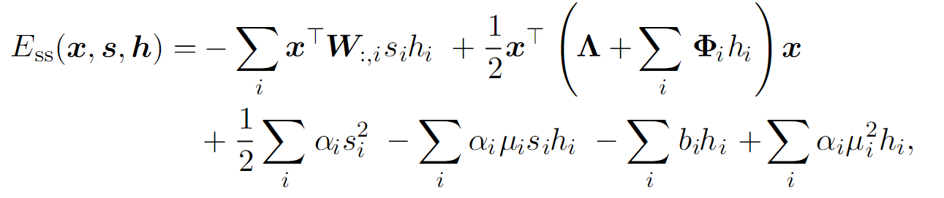
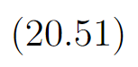
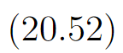
20.5.2 Undirected Models of Conditional Covariance
Formally, the ssRBM model is defined via its energy function:
where b_{i} is the offset of the spike h_{i} and Λ is a diagonal precision matrix on the observations x. The parameter α_{i} > 0 is a scalar precision parameter for the real-valued slab variable s_{i}. The parameter Φ_{i} is a non-negative diagonal matrix that defines an h-modulated quadratic penalty on x. Each µ_{i} is a mean parameter for the slab variable s_{i}.

Slide 105
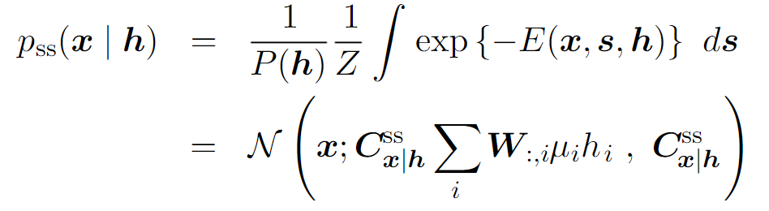



20.5.2 Undirected Models of Conditional Covariance
With the joint distribution defined via the energy function, it is relatively straightforward to derive the ssRBM conditional distributions. For example, by marginalizing out the slab variables s, the conditional distribution over the observations given the binary spike variables h is given by:
where The last equality holds only if the covariance matrix is positive definite.

Slide 106


20.5.2 Undirected Models of Conditional Covariance
Gating by the spike variables means that the true marginal distribution over xxxx is sparse. This is different from sparse coding, where samples from the model “almost never” (in the measure theoretic sense) contain zeros in the code, and MAP inference is required to impose sparsity.
Comparing the ssRBM to the mcRBM and the mPoT models, the ssRBM parametrizes the conditional covariance of the observation in a significantly different way. The mcRBM and mPoT both model the covariance structure of the observation as , using the activation of the hidden units h_{j} > 0 to enforce constraints on the conditional covariance in the direction r^{(j)}.

Slide 107
20.5.2 Undirected Models of Conditional Covariance
In contrast, the ssRBM specifies the conditional covariance of the observations using the hidden spike activations h_{i} = 1 to pinch the precision matrix along the direction specified by the corresponding weight vector. The ssRBM conditional covariance is very similar to that given by a different model: the product of probabilistic principal components analysis (PoPPCA) (Williams and Agakov, 2002). In the overcomplete setting, sparse activations with the ssRBM parametrization permit significant variance (above the nominal variance given by Λ⁻¹) only in the selected directions of the sparsely activated h_{i}. In the mcRBM or mPoT models, an overcomplete representation would mean that to capture variation in a particular direction in the observation space requires removing potentially all constraints with positive projection in that direction. This would suggest that these models are less well suited to the overcomplete setting.

Slide 108
20.5.2 Undirected Models of Conditional Covariance
The primary disadvantage of the spike and slab restricted Boltzmann machine is that some settings of the parameters can correspond to a covariance matrix that is not positive definite. Such a covariance matrix places more unnormalized probability on values that are farther from the mean, causing the integral over all possible outcomes to diverge. Generally this issue can be avoided with simple heuristic tricks. There is not yet any theoretically satisfying solution. Using constrained optimization to explicitly avoid the regions where the probability is undefined is difficult to do without being overly conservative and also preventing the model from accessing high-performing regions of parameter space.

Slide 109
20.5.2 Undirected Models of Conditional Covariance
Qualitatively, convolutional variants of the ssRBM produce excellent samples of natural images. Some examples are shown in Fig. 16.1.
The ssRBM allows for several extensions. Including higher-order interactions and average-pooling of the slab variables (Courville et al., 2014) enables the model to learn excellent features for a classifier when labeled data is scarce. Adding a term to the energy function that prevents the partition function from becoming undefined results in a sparse coding model, spike and slab sparse coding (Goodfellow et al., 2013d), also known as S3C.

Slide 110
Chapter 20 Deep Generative Models
20.6 Convolutional Boltzmann Machines
Acknowledge to: Yanan Wang
Organizers: Guoqiang Zhong, Zhaoyang Niu
Machine Learning Research Group
Ocean University of China
Qingdao, China
https://github.com/AdolfKing/DeepLearningSlides

Slide 111
20.6 Convolutional Boltzmann Machines
As seen in Chapter 9, extremely high dimensional inputs such as images place great strain on the computation, memory and statistical requirements of machine learning models. Replacing matrix multiplication by discrete convolution with a small kernel is the standard way of solving these problems for inputs that have translation invariant spatial or temporal structure. Desjardins and Bengio (2008) showed that this approach works well when applied to RBMs.

Slide 112
20.6 Convolutional Boltzmann Machines
Deep convolutional networks usually require a pooling operation so that the spatial size of each successive layer decreases. Feedforward convolutional networks often use a pooling function such as the maximum of the elements to be pooled. It is unclear how to generalize this to the setting of energy-based models. We could introduce a binary pooling unit p over n binary detector units d and enforce p = max_{i} d_{i} by setting the energy function to be ∞ whenever that constraint is violated. This does not scale well though, as it requires evaluating 2^{n} different energy configurations to compute the normalization constant. For a small 3×3 pooling region this requires 2⁹ = 512 energy function evaluations per pooling unit!

Slide 113
20.6 Convolutional Boltzmann Machines
Lee et al. (2009) developed a solution to this problem called probabilistic max pooling (not to be confused with “stochastic pooling,” which is a technique for implicitly constructing ensembles of convolutional feedforward networks). The strategy behind probabilistic max pooling is to constrain the detector units so at most one may be active at a time. This means there are only n + 1 total states (one state for each of the n detector units being on, and an additional state corresponding to all of the detector units being off). The pooling unit is on if and only if one of the detector units is on. The state with all units off is assigned energy zero. We can think of this as describing a model with a single variable that has n +1 states, or equivalently as a model that has n +1 variables that assigns energy ∞ to all but n + 1 joint assignments of variables.

Slide 114
20.6 Convolutional Boltzmann Machines
While efficient, probabilistic max pooling does force the detector units to be mutually exclusive, which may be a useful regularizing constraint in some contexts or a harmful limit on model capacity in other contexts. It also does not support overlapping pooling regions. Overlapping pooling regions are usually required to obtain the best performance from feedforward convolutional networks, so this constraint probably greatly reduces the performance of convolutional Boltzmann machines.

Slide 115
20.6 Convolutional Boltzmann Machines
Lee et al. (2009) demonstrated that probabilistic max pooling could be used to build convolutional deep Boltzmann machines. This model is able to perform operations such as filling in missing portions of its input. While intellectually appealing, this model is challenging to make work in practice, and usually does not perform as well as a classifier as traditional convolutional networks trained with supervised learning.
Many convolutional models work equally well with inputs of many different spatial sizes. For Boltzmann machines, it is difficult to change the input size for a variety of reasons. The partition function changes as the size of the input changes.

Slide 116
20.6 Convolutional Boltzmann Machines
Moreover, many convolutional networks achieve size invariance by scaling up the size of their pooling regions proportional to the size of the input, but scaling Boltzmann machine pooling regions is awkward. Traditional convolutional neural networks can use a fixed number of pooling units and dynamically increase the size of their pooling regions in order to obtain a fixed-size representation of a variable-sized input. For Boltzmann machines, large pooling regions become too expensive for the naive approach. The approach of Lee et al. (2009) of making each of the detector units in the same pooling region mutually exclusive solves the computational problems, but still does not allow variable-size pooling regions.

Slide 117
20.6 Convolutional Boltzmann Machines
For example, suppose we learn a model with 2×2 probabilistic max pooling over detector units that learn edge detectors. This enforces the constraint that only one of these edges may appear in each 2×2 region. If we then increase the size of the input image by 50% in each direction, we would expect the number of edges to increase correspondingly. Instead, if we increase the size of the pooling regions by 50% in each direction to 3×3, then the mutual exclusivity constraint now specifies that each of these edges may only appear once in a 3×3 region. As we grow a model’s input image in this way, the model generates edges with less density. Of course, these issues only arise when the model must use variable amounts of pooling in order to emit a fixed-size output vector.

Slide 118
20.6 Convolutional Boltzmann Machines
Models that use probabilistic max pooling may still accept variable-sized input images so long as the output of the model is a feature map that can scale in size proportional to the input image.
Pixels at the boundary of the image also pose some difficulty, which is exacerbated by the fact that connections in a Boltzmann machine are symmetric. If we do not implicitly zero-pad the input, then there are fewer hidden units than visible units, and the visible units at the boundary of the image are not modeled well because they lie in the receptive field of fewer hidden units. However, if we do implicitly zero-pad the input, then the hidden units at the boundary are driven by fewer input pixels, and may fail to activate when needed.

Slide 119
Chapter 20 Deep Generative Models
20.7 Boltzmann Machines for Structured or Sequential Outputs
Acknowledge to: Yanan Wang
Organizers: Guoqiang Zhong, Zhaoyang Niu
Machine Learning Research Group
Ocean University of China
Qingdao, China
https://github.com/AdolfKing/DeepLearningSlides

Slide 120
20.7 Boltzmann Machines for Structured or Sequential Outputs
In the structured output scenario, we wish to train a model that can map from some input x to some output y, and the different entries of y are related to each other and must obey some constraints. For example, in the speech synthesis task, y is a waveform, and the entire waveform must sound like a coherent utterance.
A natural way to represent the relationships between the entries in y is to use a probability distribution p(y | x). Boltzmann machines, extended to model conditional distributions, can supply this probabilistic model.

Slide 121
20.7 Boltzmann Machines for Structured or Sequential Outputs
The same tool of conditional modeling with a Boltzmann machine can be used not just for structured output tasks, but also for sequence modeling. In the latter case, rather than mapping an input x to an output y, the model must estimate a probability distribution over a sequence of variables, p(x⁽¹⁾, . . . , x^{(τ)}). Conditional Boltzmann machines can represent factors of the form p(x^{(t)} | x⁽¹⁾, . . . , x^{(t−1)}) in order to accomplish this task.

Slide 122
20.7 Boltzmann Machines for Structured or Sequential Outputs
An important sequence modeling task for the video game and film industry is modeling sequences of joint angles of skeletons used to render 3-D characters. These sequences are often collected using motion capture systems to record the movements of actors. A probabilistic model of a character’s movement allows the generation of new, previously unseen, but realistic animations. To solve this sequence modeling task, Taylor et al. (2007) introduced a conditional RBM modeling p(x^{(t)} | x^{(t−1)} , ... , x^{(t−m)}) for small m. The model is an RBM over p(x^{(t)}) whose bias parameters are a linear function of the preceding m values of x.

Slide 123
20.7 Boltzmann Machines for Structured or Sequential Outputs
When we condition on different values of x^{(t−1)} and earlier variables, we get a new RBM over x. The weights in the RBM over x never change, but by conditioning on different past values, we can change the probability of different hidden units in the RBM being active. By activating and deactivating different subsets of hidden units, we can make large changes to the probability distribution induced on x. Other variants of conditional RBM (Mnih et al., 2011) and other variants of sequence modeling using conditional RBMs are possible (Taylor and Hinton, 2009; Sutskever et al., 2009; Boulanger-Lewandowski et al., 2012).

Slide 124
20.7 Boltzmann Machines for Structured or Sequential Outputs
Another sequence modeling task is to model the distribution over sequences of musical notes used to compose songs. Boulanger-Lewandowski et al. (2012) introduced the RNN-RBM sequence model and applied it to this task. The RNN- RBM is a generative model of a sequence of frames x^{(t)} consisting of an RNN that emits the RBM parameters for each time step. Unlike the model described above, the RNN emits all of the parameters of the RBM, including the weights. To train the model, we need to be able to back-propagate the gradient of the loss function through the RNN. The loss function is not applied directly to the RNN outputs.

Slide 125
20.7 Boltzmann Machines for Structured or Sequential Outputs
Instead, it is applied to the RBM. This means that we must approximately differentiate the loss with respect to the RBM parameters using contrastive divergence or a related algorithm. This approximate gradient may then be back-propagated through the RNN using the usual back-propagation through time algorithm.

Slide 126
Chapter 20 Deep Generative Models
20.8 Other Boltzmann Machines
Acknowledge to: Yanan Wang
Organizers: Guoqiang Zhong, Zhaoyang Niu
Machine Learning Research Group
Ocean University of China
Qingdao, China
https://github.com/AdolfKing/DeepLearningSlides

Slide 127
20.8 Other Boltzmann Machines
Many other variants of Boltzmann machines are possible.
Boltzmann machines may be extended with different training criteria. We have focused on Boltzmann machines trained to approximately maximize the generative criterion log p(v). It is also possible to train discriminative RBMs that aim to maximize log p( y | v) instead (Larochelle and Bengio, 2008). This approach often performs the best when using a linear combination of both the generative and the discriminative criteria. Unfortunately, RBMs do not seem to be as powerful supervised learners as MLPs, at least using existing methodology.

Slide 128
20.8 Other Boltzmann Machines
Most Boltzmann machines used in practice have only second-order interactions in their energy functions, meaning that their energy functions are the sum of many terms and each individual term only includes the product between two random variables. An example of such a term is v_{i}W_{i,j}h_{j}. It is also possible to train higher-order Boltzmann machines (Sejnowski, 1987) whose energy function terms involve the products between many variables. Three-way interactions between a hidden unit and two different images can model spatial transformations from one frame of video to the next (Memisevic and Hinton, 2007, 2010).

Slide 129
20.8 Other Boltzmann Machines
Multiplication by a one-hot class variable can change the relationship between visible and hidden units depending on which class is present (Nair and Hinton, 2009). One recent example of the use of higher-order interactions is a Boltzmann machine with two groups of hidden units, with one group of hidden units that interact with both the visible units v and the class label y, and another group of hidden units that interact only with the v input values (Luo et al., 2011).

Slide 130
20.8 Other Boltzmann Machines
This can be interpreted as encouraging some hidden units to learn to model the input using features that are relevant to the class but also to learn extra hidden units that explain nuisance details that are necessary for the samples of v to be realistic but do not determine the class of the example. Another use of higher-order interactions is to gate some features. Sohn et al. (2013) introduced a Boltzmann machine with third-order interactions with binary mask variables associated with each visible unit. When these masking variables are set to zero, they remove the influence of a visible unit on the hidden units. This allows visible units that are not relevant to the classification problem to be removed from the inference pathway that estimates the class.

Slide 131
20.8 Other Boltzmann Machines
More generally, the Boltzmann machine framework is a rich space of models permitting many more model structures than have been explored so far. Developing a new form of Boltzmann machine requires some more care and creativity than developing a new neural network layer, because it is often difficult to find an energy function that maintains tractability of all of the different conditional distributions needed to use the Boltzmann machine, but despite this required effort the field remains open to innovation.

Slide 132
Chapter 20 Deep Generative Models
20.9 Back-Propagation through Random Operations
Acknowledge to: Yanan Wang
Organizers: Guoqiang Zhong, Zhaoyang Niu
Machine Learning Research Group
Ocean University of China
Qingdao, China
https://github.com/AdolfKing/DeepLearningSlides

Slide 133
20.9 Back-Propagation through Random Operation
Traditional neural networks implement a deterministic transformation of some input variables x. When developing generative models, we often wish to extend neural networks to implement stochastic transformations of x. One straightforward way to do this is to augment the neural network with extra inputs z that are sampled from some simple probability distribution, such as a uniform or Gaussian distribution. The neural network can then continue to perform deterministic computation internally, but the function f(x, z) will appear stochastic to an observer who does not have access to z. Provided that f is continuous and differentiable, we can then compute the gradients necessary for training using back-propagation as usual.

Slide 134
20.9 Back-Propagation through Random Operations
As an example, let us consider the operation consisting of drawing samples y from a Gaussian distribution with mean µ and variance σ²:
y ∼ N (µ, σ²). (20.55)
Because an individual sample of y is not produced by a function, but rather by a sampling process whose output changes every time we query it, it may seem counterintuitive to take the derivatives of y with respect to the parameters of
its distribution, µ and σ². However, we can rewrite the sampling process as transforming an underlying random value z ∼ N(z; 0, 1) to obtain a sample from the desired distribution:
y = µ + σz (20.56)

Slide 135
20.9 Back-Propagation through Random Operations
We are now able to back-propagate through the sampling operation, by regarding it as a deterministic operation with an extra input z. Crucially, the extra input is a random variable whose distribution is not a function of any of the variables whose derivatives we want to calculate. The result tells us how an infinitesimal change in µ or σ would change the output if we could repeat the sampling operation again with the same value of z.

Slide 136
20.9 Back-Propagation through Random Operations
Being able to back-propagate through this sampling operation allows us to incorporate it into a larger graph. We can build elements of the graph on top of the output of the sampling distribution. For example, we can compute the derivatives of some loss function J(y). We can also build elements of the graph whose outputs are the inputs or the parameters of the sampling operation. For example, we could build a larger graph with µ = f(x; θ) and σ = g(x; θ). In this augmented graph, we can use back-propagation through these functions to derive ∇ _{θ}J(y).

Slide 137
20.9 Back-Propagation through Random Operations
The principle used in this Gaussian sampling example is more generally applicable. We can express any probability distribution of the form p(y; θ) or p(y | x;θ) as p(y | ω), where ω is a variable containing both parameters θ , and if applicable, the inputs x. Given a value y sampled from distribution p(y | ω), where ω may in turn be a function of other variables, we can rewrite
as
where z is a source of randomness.

Slide 138
20.9 Back-Propagation through Random Operations
We may then compute the derivatives of y with respect to ω using traditional tools such as the back-propagation algorithm applied to f, so long as f is continuous and differentiable almost everywhere. Crucially, ω must not be a function of z, and z must not be a function of ω. This technique is often called the reparametrization trick, stochastic back-propagation or perturbation analysis.
The requirement that f be continuous and differentiable of course requires y to be continuous. If we wish to back-propagate through a sampling process that produces discrete-valued samples, it may still be possible to estimate a gradient on ω, using reinforcement learning algorithms such as variants of the REINFORCE algorithm (Williams, 1992), discussed in Sec. 20.9.1.

Slide 139
20.9 Back-Propagation through Random Operations
In neural network applications, we typically choose z to be drawn from some simple distribution, such as a unit uniform or unit Gaussian distribution, and achieve more complex distributions by allowing the deterministic portion of the network to reshape its input.

Slide 140
20.9 Back-Propagation through Random Operations
The idea of propagating gradients or optimizing through stochastic operations dates back to the mid-twentieth century (Price, 1958; Bonnet, 1964) and was first used for machine learning in the context of reinforcement learning (Williams, 1992). More recently, it has been applied to variational approximations (Opper and Archambeau, 2009) and stochastic or generative neural networks (Bengio et al., 2013b; Kingma, 2013; Kingma and Welling, 2014b, a; Rezende et al., 2014; Goodfellow et al., 2014c). Many networks, such as denoising autoencoders or networks regularized with dropout, are also naturally designed to take noise as an input without requiring any special reparametrization to make the noise independent from the model.

Slide 141
20.9.1 Back-Propagating through Discrete Stochastic Operations
When a model emits a discrete variable y, the reparametrization trick is not applicable. Suppose that the model takes inputs x and parameters θ, both encapsulated in the vector ω, and combines them with random noise z to produce y:
y = f(z; ω). (20.59)
Because y is discrete, f must be a step function. The derivatives of a step function are not useful at any point. Right at each step boundary, the derivatives are undefined, but that is a small problem. The large problem is that the derivatives are zero almost everywhere, on the regions between step boundaries. The derivatives of any cost function J(y) therefore do not give any information for how to update the model parameters θ.

Slide 142
20.9.1 Back-Propagating through Discrete Stochastic Operations
The REINFORCE algorithm (REward Increment = Non-negative Factor × Offset Reinforcement × Characteristic Eligibility) provides a framework defining a family of simple but powerful solutions (Williams, 1992). The core idea is that even though J(f(z;ω)) is a step function with useless derivatives, the expected cost E_{z∼p(z)}J (f(z; ω)) is often a smooth function amenable to gradient descent. Although that expectation is typically not tractable when y is high-dimensional (or is the result of the composition of many discrete stochastic decisions), it can be estimated without bias using a Monte Carlo average. The stochastic estimate of the gradient can be used with SGD or other stochastic gradient-based optimization techniques.

Slide 143

20.9.1 Back-Propagating through Discrete Stochastic Operations
The simplest version of REINFORCE can be derived by simply differentiating the expected cost:

Slide 144

20.9.1 Back-Propagating through Discrete Stochastic Operations
Eq. 20.61 relies on the assumption that J does not reference ω directly. It is trivial to extend the approach to relax this assumption. Eq. 20.62 exploits the derivative rule for the logarithm, $\frac{ ∂ log p(y)}{∂ω}\frac{1}{p(y)}\frac{∂p(y)}{∂ω}$. Eq. 20.63 gives an unbiased Monte Carlo estimator of the gradient.
Anywhere we write p(y) in this section, one could equally write p(y | x). This is because p(y) is parametrized by ω, and ω contains both θ and x, if x is present.

Slide 145
20.9.1 Back-Propagating through Discrete Stochastic Operations
One issue with the above simple REINFORCE estimator is that it has a very high variance, so that many samples of y need to be drawn to obtain a good estimator of the gradient, or equivalently, if only one sample is drawn, SGD will converge very slowly and will require a smaller learning rate. It is possible to considerably reduce the variance of that estimator by using variance reduction methods (Wilson, 1984; L’Ecuyer, 1994). The idea is to modify the estimator so that its expected value remains unchanged but its variance get reduced. In the context of REINFORCE, the proposed variance reduction methods involve the computation of a baseline that is used to offset J(y).

Slide 146


20.9.1 Back-Propagating through Discrete Stochastic Operations
Note that any offset b(ω) that does not depend on y would not change the expectation of the estimated gradient because
which means that

Slide 147


20.9.1 Back-Propagating through Discrete Stochastic Operations
Furthermore, we can obtain the optimal b(ω) by computing the variance of (J(y) − b(ω)) ∂ log p(y) ∂ω under p(y) and minimizing with respect to b(ω). What we find is that this optimal baseline b∗ (ω)i is different for each element ω_{i} of the vector ω:
The gradient estimator with respect to ω_{i} then becomes
where b(ω)_{i} estimates the above b∗(ω)_{i}.

Slide 148

20.9.1 Back-Propagating through Discrete Stochastic Operations
The estimate b is usually obtained by adding extra outputs to the neural network and training the new outputs to estimate $Ep(y)[J(y)\frac{∂log p(y)2}{∂ωi}]$ and $Ep(y)[\frac{∂logp(y)2}{∂ωi}]$ for each element of ω. These extra outputs can be trained with the mean squared error objective, using respectively J(y)$\frac{∂log p(y)2}{∂ωi}$and $\frac{∂log p(y)2}{∂ωi}$ as targets when y is sampled from p(y), for a given ω. The estimate b may then be recovered by substituting these estimates into Eq. 20.69. Mnih and Gregor (2014) preferred to use a single shared output (across all elements i of ω) trained with the target J(y), using as baseline b(ω) ≈ E_{p(y)}[J(y)].

Slide 149
20.9.1 Back-Propagating through Discrete Stochastic Operations
Variance reduction methods have been introduced in the reinforcement learning context (Sutton et al., 2000; Weaver and Tao, 2001), generalizing previous work on the case of binary reward by Dayan (1990). See Bengio et al. (2013b), Mnih and Gregor (2014), Ba et al. (2014), Mnih et al. (2014), or Xu et al. (2015) for examples of modern uses of the REINFORCE algorithm with reduced variance in the context of deep learning. In addition to the use of an input-dependent baseline b(ω), Mnih and Gregor (2014) found that the scale of (J(y) − b(ω)) could be adjusted during training by dividing it by its standard deviation estimated by a moving average during training, as a kind of adaptive learning rate, to counter the effect of important variations that occur during the course of training in the magnitude of this quantity. Mnih and Gregor (2014) called this heuristic variance normalization.

Slide 150
20.9.1 Back-Propagating through Discrete Stochastic Operations
REINFORCE-based estimators can be understood as estimating the gradient by correlating choices of y with corresponding values of J(y). If a good value of y is unlikely under the current parametrization, it might take a long time to obtain it by chance, and get the required signal that this configuration should be reinforced.

Slide 151
Chapter 20 Deep Generative Models
20.10 Directed Generative Nets
Acknowledge to: Zhenlin Fan, Wei Gao
Organizers: Guoqiang Zhong, Zhaoyang Niu
Machine Learning Research Group
Ocean University of China
Qingdao, China
https://github.com/AdolfKing/DeepLearningSlides

Slide 152
20.10 Directed Generative Nets
As discussed in Chapter 16, directed graphical models make up a prominent class of graphical models. While directed graphical models have been very popular within the greater machine learning community, within the smaller deep learning community they have until roughly 2013 been overshadowed by undirected models
such as the RBM.
In this section we review some of the standard directed graphical models that
have traditionally been associated with the deep learning community.

Slide 153
20.10 Directed Generative Nets
We have already described deep belief networks, which are a partially directed model. We have also already described sparse coding models, which can be thought of as shallow directed generative models. They are often used as feature learners in the context of deep learning, though they tend to perform poorly at sample generation and density estimation. We now describe a variety of deep, fully directed models.

Slide 154


20.10.1 Sigmoid Belief Nets
Sigmoid belief networks (Neal, 1990) are a simple form of directed graphical model with a specific kind of conditional probability distribution. In general, we can think of a sigmoid belief network as having a vector of binary states $s$, with each element of the state influenced by its ancestors:
The most common structure of sigmoid belief network is one that is divided into many layers, with ancestral sampling proceeding through a series of many hidden layers and then ultimately generating the visible layer.

Slide 155
20.10.1 Sigmoid Belief Nets
This structure is very similar to the deep belief network, except that the units at the beginning of the sampling process are independent from each other, rather than sampled from a restricted Boltzmann machine. Such a structure is interesting for a variety of reasons. One reason is that the structure is a universal approximator of probability distributions over the visible units, in the sense that it can approximate any probability distribution over binary variables arbitrarily well, given enough depth, even if the width of the individual layers is restricted to the dimensionality of the visible layer (Sutskever and Hinton, 2008).

Slide 156
20.10.1 Sigmoid Belief Nets
While generating a sample of the visible units is very efficient in a sigmoid belief network, most other operations are not. Inference over the hidden units given the visible units is intractable. Mean field inference is also intractable because the variational lower bound involves taking expectations of cliques that encompass entire layers. This problem has remained difficult enough to restrict the popularity of directed discrete networks.
One approach for performing inference in a sigmoid belief network is to construct a different lower bound that is specialized for sigmoid belief networks (Saul et al., 1996). This approach has only been applied to very small networks.

Slide 157
20.10.1 Sigmoid Belief Nets
Another approach is to use learned inference mechanisms as described in Sec. 19.5. The Helmholtz machine (Dayan et al., 1995; Dayan and Hinton, 1996) is a sigmoid belief network combined with an inference network that predicts the parameters of the mean field distribution over the hidden units. Modern approaches (Gregor et al., 2014; Mnih and Gregor, 2014) to sigmoid belief networks still use this inference network approach. These techniques remain difficult due to the discrete nature of the latent variables. One cannot simply back-propagate through the output of the inference network, but instead must use the relatively unreliable machinery for backpropagating through discrete sampling processes, described in Sec. 20.9.1.

Slide 158
20.10.1 Sigmoid Belief Nets
Recent approaches based on importance sampling, reweighted wake-sleep (Bornschein and Bengio, 2015) and bidirectional Helmholtz machines (Bornschein et al., 2015) make it possible to quickly train sigmoid belief networks and reach state-of-the-art performance on benchmark tasks.
A special case of sigmoid belief networks is the case where there are no latent variables. Learning in this case is efficient, because there is no need to marginalize latent variables out of the likelihood. A family of models called auto-regressive networks generalize this fully visible belief network to other kinds of variables besides binary variables and other structures of conditional distributions besides loglinear relationships. Auto-regressive networks are described later, in Sec. 20.10.7.

Slide 159

20.10.2 Differentiable Generator Nets
Many generative models are based on the idea of using a differentiable generator network. The model transforms samples of latent variables $z$ to samples $x$ or to distributions over samples $x$ using a differentiable function $g(z;θ^{(g)})$which is typically represented by a neural network. This model class includes variational autoencoders, which pair the generator net with an inference net, generative adversarial networks, which pair the generator network with a discriminator network, and techniques that train generator networks in isolation.
Generator networks are essentially just parametrized computational procedures for generating samples, where the architecture provides the family of possible distributions to sample from and the parameters select a distribution from within that family.

Slide 160

20.10.2 Differentiable Generator Nets
As an example, the standard procedure for drawing samples from a normal distribution with mean $μ$ and covariance Σ is to feed samples $z$ from a normal distribution with zero mean and identity covariance into a very simple generator network. This generator network contains just one affine layer:
where L is given by the Cholesky decomposition of Σ.
Pseudorandom number generators can also use nonlinear transformations of simple distributions. For example, inverse transform sampling (Devroye, 2013) draws a scalar $z$ from U(0,1) and applies a nonlinear transformation to a scalar $x$.

Slide 161

20.10.2 Differentiable Generator Nets
In this case $g(z)$is given by the inverse of the cumulative distribution function $F(x)$= $\int_{−∞}^{x}{p\left(v\right)dv}$. If we are able to specify $p(x)$, integrate over $x$, and invert the resulting function, we can sample from $p(x)$ without using machine learning.
To generate samples from more complicated distributions that are difficult to specify directly, difficult to integrate over, or whose resulting integrals are difficult to invert, we use a feedforward network to represent a parametric family of nonlinear functions $g$ , and use training data to infer the parameters selecting the desired function.

Slide 162



20.10.2 Differentiable Generator Nets
We can think of $g$ as providing a nonlinear change of variables that transforms the distribution over z into the desired distribution over x.
Recall from Eq. 3.47 that, for invertible, differentiable, continuous $g$,
This implicitly imposes a probability distribution over x:
$p_{x}(x)=\frac{p_{z}\left(g^{−1}\left(x\right)\right)}{|det⁡(\frac{∂g}{∂z})|}$.

Slide 163

20.10.2 Differentiable Generator Nets
Of course, this formula may be difficult to evaluate, depending on the choice of $g$, so we often use indirect means of learning $g$, rather than trying to maximize log $p(x)$ directly.
In some cases, rather than using $g$ to provide a sample of $x$ directly, we use $g$
to define a conditional distribution over $x$. For example, we could use a generator net whose final layer consists of sigmoid outputs to provide the mean parameters of Bernoulli distributions:

Slide 164

20.10.2 Differentiable Generator Nets
In this case, when we use $g$ to define $p(x | z)$,we impose a distribution over $x$ by marginalizing $z$:
Both approaches define a distribution $p_{g}(x)$ and allow us to train various criteria of $p_{g}$ using the reparametrization trick of Sec. 20.9.
The two different approaches to formulating generator nets—emitting the parameters of a conditional distribution versus directly emitting samples—have complementary strengths and weaknesses.

Slide 165

20.10.2 Differentiable Generator Nets
When the generator net defines a conditional distribution over $x$, it is capable of generating discrete data as well as continuous data. When the generator net provides samples directly, it is capable of generating only continuous data (we could introduce discretization in the forward propagation, but this would lose the ability to learn the model using back-propagation). The advantage to direct sampling is that we are no longer forced to use conditional distributions whose form can be easily written down and algebraically manipulated by a human designer.

Slide 166
20.10.2 Differentiable Generator Nets
Approaches based on differentiable generator networks are motivated by the success of gradient descent applied to differentiable feedforward networks for classification. In the context of supervised learning, deep feedforward networks trained with gradient-based learning seem practically guaranteed to succeed given enough hidden units and enough training data. Can this same recipe for success transfer to generative modeling?

Slide 167

20.10.2 Differentiable Generator Nets
Generative modeling seems to be more difficult than classification or regression because the learning process requires optimizing intractable criteria. In the context of differentiable generator nets, the criteria are intractable because the data does not specify both the inputs $z$ and the outputs $x$ of the generator net. In the case of supervised learning, both the inputs $x$ and the outputs $y$ were given, and the optimization procedure needs only to learn how to produce the specified mapping. In the case of generative modeling, the learning procedure needs to determine how to arrange $z$ space in a useful way and additionally how to map from $z$ to $x$.

Slide 168

20.10.2 Differentiable Generator Nets
Dosovitskiy et al. (2015) studied a simplified problem, where the correspondence between $z$ and $x$ is given. Specifically, the training data is computer-rendered imagery of chairs. The latent variables $z$ are parameters given to the rendering engine describing the choice of which chair model to use, the position of the chair, and other configuration details that affect the rendering of the image. Using this synthetically generated data, a convolutional network is able to learn to map $z$descriptions of the content of an image to $x$ approximations of rendered images. This suggests that contemporary differentiable generator networks have sufficient model capacity to be good generative models, and that contemporary optimization algorithms have the ability to fit them.

Slide 169

20.10.2 Differentiable Generator Nets
The difficulty lies in determining how to train generator networks when the value of $z$ for each $x$ is not fixed and known ahead of each time.
The following sections describe several approaches to training differentiable generator nets given only training samples of $x$.

Slide 170

20.10.3 Variational Autoencoders
The variational autoencoder or VAE (Kingma, 2013; Rezende et al., 2014) is a directed model that uses learned approximate inference and can be trained purely with gradient-based methods.
To generate a sample from the model, the VAE first draws a sample $z$ from the code distribution $p_{model}(z)$. The sample is then run through a differentiable generator network $g(z)$. Finally, $x$ is sampled from a distribution $p_{model}\left(x;g\left(z\right)\right)=p_{model}\left(x|z\right)$. However, during training, the approximate inference network (or encoder) $q(z|x)$is used to obtain $z$ and $p_{model}\left(x|z\right)$is then viewed as a decoder network.

Slide 171


20.10.3 Variational Autoencoders
The key insight behind variational autoencoders is that they may be trained by maximizing the variational lower bound $L(q)$ associated with data point $x$:
In Eq. 20.77, we recognize the first term as the joint log-likelihood of the visible and hidden variables under the approximate posterior over the latent variables (just like with EM, except that we use an approximate rather than the exact posterior). We recognize also a second term, the entropy of the approximate posterior.

Slide 172

20.10.3 Variational Autoencoders
When $q$ is chosen to be a Gaussian distribution, with noise added to a predicted mean value, maximizing this entropy term encourages increasing the standard deviation of this noise. More generally, this entropy term encourages the variational posterior to place high probability mass on many $z$ values that could have generated $x$, rather than collapsing to a single point estimate of the most likely value. In Eq. 20.78, we recognize the first term as the reconstruction log-likelihood found in other autoencoders. The second term tries to make the approximate posterior distribution $q(z|x)$and the model prior $p_{model}(z)$ approach each other.

Slide 173

20.10.3 Variational Autoencoders
Traditional approaches to variational inference and learning infer q via an optimization algorithm, typically iterated fixed point equations (Sec. 19.4). These approaches are slow and often require the ability to compute $E_{z\sim q}logp_{model}\left(z,x\right)$in closed form. The main idea behind the variational autoencoder is to train a parametric encoder (also sometimes called an inference network or recognition model) that produces the parameters of $q$ . So long as $z$ is a continuous variable, we can then back-propagate through samples of $z$ drawn from $q\left(z | x\right)=q(z;f(x;θ))$in order to obtain a gradient with respect to$θ.$ Learning then consists solely of maximizing $L$ with respect to the parameters of the encoder and decoder. All of the expectations in $L$ may be approximated by Monte Carlo sampling.

Slide 174

20.10.3 Variational Autoencoders
The variational autoencoder approach is elegant, theoretically pleasing, and simple to implement. It also obtains excellent results and is among the state of the art approaches to generative modeling. Its main drawback is that samples from variational autoencoders trained on images tend to be somewhat blurry. The causes of this phenomenon are not yet known. One possibility is that the blurriness is an intrinsic effect of maximum likelihood, which minimizes $D_{KL}(p_{data}||p_{model})$.As illustrated in Fig. 3.6, this means that the model will assign high probability to points that occur in the training set, but may also assign high probability to other points. These other points may include blurry images.

Slide 175

20.10.3 Variational Autoencoders
Part of the reason that the model would choose to put probability mass on blurry images rather than some other part of the space is that the variational autoencoders used in practice usually have a Gaussian distribution for $p_{model}\left(x;g\left(z\right)\right)$. Maximizing a lower bound on the likelihood of such a distribution is similar to training a traditional autoencoder with mean squared error, in the sense that it has a tendency to ignore features of the input that occupy few pixels or that cause only a small change in the brightness of the pixels that they occupy. This issue is not specific to VAEs and is shared with generative models that optimize a log-likelihood, or equivalently, $D_{KL}(p_{data}||p_{model})$, as argued by Theis et al. (2015) and by Huszar (2015).

Slide 176

20.10.3 Variational Autoencoders
Another troubling issue with contemporary VAE models is that they tend to use only a small subset of the dimensions of $z$, as if the encoder was not able to transform enough of the local directions in input space to a space where the marginal distribution matches the factorized prior.
The VAE framework is very straightforward to extend to a wide range of model architectures. This is a key advantage over Boltzmann machines, which require extremely careful model design to maintain tractability. VAEs work very well with a diverse family of differentiable operators. One particularly sophisticated VAE is the deep recurrent attention writer or DRAW model (Gregor et al., 2015). DRAW uses a recurrent encoder and recurrent decoder combined with an attention mechanism.

Slide 177
20.10.3 Variational Autoencoders
The generation process for the DRAW model consists of sequentially visiting different small image patches and drawing the values of the pixels at those points. VAEs can also be extended to generate sequences by defining variational RNNs (Chung et al., 2015b) by using a recurrent encoder and decoder within the VAE framework. Generating a sample from a traditional RNN involves only non-deterministic operations at the output space. Variational RNNs also have random variability at the potentially more abstract level captured by the VAE latent variables.

Slide 178


20.10.3 Variational Autoencoders
The VAE framework has been extended to maximize not just the traditional variational lower bound, but instead the importance weighted autoencoder (Burda et al., 2015) objective:
This new objective is equivalent to the traditional lower bound $L$ when $k$ = 1. However, it may also be interpreted as forming an estimate of the true $logp_{model}\left(x\right)$using importance sampling of $z$ from proposal distribution $q\left(z | x\right).$The importance weighted autoencoder objective is also a lower bound on $logp_{model}\left(x\right)$and becomes tighter as $k$ increases.

Slide 179
20.10.3 Variational Autoencoders
Variational autoencoders have some interesting connections to the MP-DBM and other approaches that involve back-propagation through the approximate inference graph (Goodfellow et al., 2013b; Stoyanov et al., 2011; Brakel et al., 2013). These previous approaches required an inference procedure such as mean field fixed point equations to provide the computational graph. The variational autoencoder is defined for arbitrary computational graphs, which makes it applicable to a wider range of probabilistic model families because there is no need to restrict the choice of models to those with tractable mean field fixed point equations.

Slide 180

20.10.3 Variational Autoencoders
The variational autoencoder also has the advantage that it increases a bound on the log-likelihood of the model, while the criteria for the MP-DBM and related models are more heuristic and have little probabilistic interpretation beyond making the results of approximate inference accurate. One disadvantage of the variational autoencoder is that it learns an inference network for only one problem, inferring $z$ given $x$. The older methods are able to perform approximate inference over any subset of variables given any other subset of variables, because the mean field fixed point equations specify how to share parameters between the computational graphs for all of these different problems.

Slide 181
20.10.3 Variational Autoencoders
One very nice property of the variational autoencoder is that simultaneously training a parametric encoder in combination with the generator network forces the model to learn a predictable coordinate system that the encoder can capture. This makes it an excellent manifold learning algorithm. See Fig. 20.6 for examples of low-dimensional manifolds learned by the variational autoencoder. In one of the cases demonstrated in the figure, the algorithm discovered two independent factors of variation present in images of faces: angle of rotation and emotional expression.

Slide 182

20.10.3 Variational Autoencoders
Figure 20.6: Examples of two-dimensional coordinate systems for high-dimensional manifolds, learned by a variational autoencoder (Kingma and Welling, 2014a). Two dimensions may be plotted directly on the page for visualization, so we can gain an understanding of how the model works by training a model with a 2-D latent code, even if we believe the intrinsic dimensionality of the data manifold is much higher. The images shown are not examples from the training set but images x actually generated by the model p(x | z ), simply by changing the 2-D “code” z (each image corresponds to a diﬀerent choice of “code” z on a 2-D uniform grid). (Left) The two-dimensional map of the Frey faces manifold. One dimension that has been discovered (horizontal) mostly corresponds to a rotation of the face, while the other (vertical) corresponds to the emotional expression. The (Right) two-dimensional map of the MNIST manifold.

Slide 183

20.10.4 Generative Adversarial Networks
Generative adversarial networks or GANs (Goodfellow et al., 2014c) are another generative modeling approach based on differentiable generator networks.
Generative adversarial networks are based on a game theoretic scenario in which the generator network must compete against an adversary. The generator network directly produces samples $x=g(z;θ^{(g)})$. Its adversary, the discriminator network, attempts to distinguish between samples drawn from the training data and samples drawn from the generator. The discriminator emits a probability value given $d\left(x;θ^{(d)}\right)$, indicating the probability that $x$ is a real training example rather than a fake sample drawn from the model.

Slide 184

20.10.4 Generative Adversarial Networks
The simplest way to formulate learning in generative adversarial networks is as a zero-sum game, in which a function $v\left(θ^{(g)};θ^{(d)}\right)$ determines the payoff of the discriminator. The generator receives $−v\left(θ^{(g)};θ^{(d)}\right)$as its own payoff. During learning, each player attempts to maximize its own payoff, so that at convergence
The default choice for $v$ is

Slide 185

20.10.4 Generative Adversarial Networks
This drives the discriminator to attempt to learn to correctly classify samples as real or fake. Simultaneously, the generator attempts to fool the classifier into believing its samples are real. At convergence, the generator’s samples are indistinguishable from real data, and the discriminator outputs $\frac{1}{2}$ everywhere. The discriminator may then be discarded.
The main motivation for the design of GANs is that the learning process requires neither approximate inference nor approximation of a partition function gradient. In the case where $\max_{d} v(g,d)$ is convex in $θ^{(g)}$ (such as the case where optimization is performed directly in the space of probability density functions) then the procedure is guaranteed to converge and is asymptotically consistent.

Slide 186

20.10.4 Generative Adversarial Networks
Unfortunately, learning in GANs can be difficult in practice when g and d are represented by neural networks and $\max_{d} v(g,d)$ is not convex. Goodfellow (2014) identified non-convergence as an issue that may cause GANs to underfit. In general, simultaneous gradient descent on two players’ costs is not guaranteed to reach an equilibrium. Consider for example the value function $v\left(a,b\right)=ab$ , where one player controls $a$ and incurs cost $ab$, while the other player controls $b$ and receives a cost $−ab$. If we model each player as making infinitesimally small gradient steps, each player reducing their own cost at the expense of the other player, then $a$ and $b$ go into a stable, circular orbit, rather than arriving at the equilibrium point at the origin. Note that the equilibria for a minimax game are not local minima of $v$.

Slide 187

20.10.4 Generative Adversarial Networks
Instead, they are points that are simultaneously minima for both players’ costs. This means that they are saddle points of $v$ that are local minima with respect to the first player’s parameters and local maxima with respect to the second player’s parameters. It is possible for the two players to take turns increasing then decreasing $v$ forever, rather than landing exactly on the saddle point where neither player is capable of reducing their cost. It is not known to what extent this non-convergence problem affects GANs.

Slide 188
20.10.4 Generative Adversarial Networks
Goodfellow (2014) identified an alternative formulation of the payoffs, in which the game is no longer zero-sum, that has the same expected gradient as maximum likelihood learning whenever the discriminator is optimal. Because maximum likelihood training converges, this reformulation of the GAN game should also converge, given enough samples. Unfortunately, this alternative formulation does not seem to perform well in practice, possibly due to suboptimality of the discriminator, or possibly due to high variance around the expected gradient.

Slide 189
20.10.4 Generative Adversarial Networks
In practice, the best-performing formulation of the GAN game is a different formulation that is neither zero-sum nor equivalent to maximum likelihood, introduced by Goodfellow et al. (2014c) with a heuristic motivation. In this best-performing formulation, the generator aims to increase the log probability that the discriminator makes a mistake, rather than aiming to decrease the log probability that the discriminator makes the correct prediction. This reformulation is motivated solely by the observation that it causes the derivative of the generator’s cost function with respect to the discriminator’s logits to remain large even in the situation where the discriminator confidently rejects all generator samples.

Slide 190
20.10.4 Generative Adversarial Networks
Stabilization of GAN learning remains an open problem. Fortunately, GAN learning performs well when the model architecture and hyperparameters are carefully selected. Radford et al. (2015) crafted a deep convolutional GAN (DCGAN) that performs very well for image synthesis tasks, and showed that its latent representation space captures important factors of variation, as shown in Fig. 15.9. See Fig. 20.7 for examples of images generated by a DCGAN generator.

Slide 191

20.10.4 Generative Adversarial Networks
The GAN learning problem can also be simplified by breaking the generation process into many levels of detail. It is possible to train conditional GANs (Mirza and Osindero, 2014) that learn to sample from a distribution $p(x | y)$rather than simply sampling from a marginal distribution $p(x)$. Denton et al. (2015) showed that a series of conditional GANs can be trained to first generate a very low-resolution version of an image, then incrementally add details to the image.

Slide 192

20.10.4 Generative Adversarial Networks
Figure 20.7: Images generated by GANs trained on the LSUN dataset. (Left) Images of bedrooms generated by a DCGAN model, reproduced with permission from Radford et al. (2015). (Right) Images of churches generated by a LAPGAN model, reproduced with permission from Denton et al. (2015).

Slide 193
20.10.4 Generative Adversarial Networks
This technique is called the LAPGAN model, due to the use of a Laplacian pyramid to generate the images containing varying levels of detail. LAPGAN generators are able to fool not only discriminator networks but also human observers, with experimental subjects identifying up to 40% of the outputs of the network as being real data. See Fig. 20.7 for examples of images generated by a LAPGAN generator.
One unusual capability of the GAN training procedure is that it can fit probability distributions that assign zero probability to the training points. Rather than maximizing the log probability of specific points, the generator net learns to trace out a manifold whose points resemble training points in some way.

Slide 194
20.10.4 Generative Adversarial Networks
Somewhat paradoxically, this means that the model may assign a log-likelihood of negative infinity to the test set, while still representing a manifold that a human observer judges to capture the essence of the generation task. This is not clearly an advantage or a disadvantage, and one may also guarantee that the generator network assigns non-zero probability to all points simply by making the last layer of the generator network add Gaussian noise to all of the generated values. Generator networks that add Gaussian noise in this manner sample from the same distribution that one obtains by using the generator network to parametrize the mean of a conditional Gaussian distribution.

Slide 195
20.10.4 Generative Adversarial Networks
Dropout seems to be important in the discriminator network. In particular, units should be stochastically dropped while computing the gradient for the generator network to follow. Following the gradient of the deterministic version of the discriminator with its weights divided by two does not seem to be as effective. Likewise, never using dropout seems to yield poor results.
While the GAN framework is designed for differentiable generator networks, similar principles can be used to train other kinds of models. For example, self-supervised boosting can be used to train an RBM generator to fool a logistic regression discriminator (Welling et al., 2002).

Slide 196
20.10.5 Generative Moment Matching Networks
Generative moment matching networks (Li et al., 2015; Dziugaite et al., 2015) are another form of generative model based on differentiable generator networks. Unlike VAEs and GANs, they do not need to pair the generator network with any other network-neither an inference network as used with VAEs nor a discriminator network as used with GANs.
These networks are trained with a technique called . The moment matching basic idea behind moment matching is to train the generator in such a way that many of the statistics of samples generated by the model are as similar as possible to those of the statistics of the examples in the training set.

Slide 197

20.10.5 Generative Moment Matching Networks
In this context, a moment is an expectation of different powers of a random variable. For example, the first moment is the mean, the second moment is the mean of the squared values, and so on. In multiple dimensions, each element of the random vector may be raised to different powers, so that a moment may be any quantity of the form
where $n={[n_{1},n_{2}, …,n_{d}]}^{T}$ is a vector of non-negative integers.

Slide 198
20.10.5 Generative Moment Matching Networks
Upon first examination, this approach seems to be computationally infeasible. For example, if we want to match all the moments of the form x_{i}x_{j}, then we need to minimize the difference between a number of values that is quadratic in the dimension of x. Moreover, even matching all of the first and second moments would only be sufficient to fit a multivariate Gaussian distribution, which captures only linear relationships between values. Our ambitions for neural networks are to capture complex nonlinear relationships, which would require far more moments. GANs avoid this problem of exhaustively enumerating all moments by using a updated discriminator, that automatically focuses its attention on whichever statistic the generator network is matching the least effectively.

Slide 199
20.10.5 Generative Moment Matching Networks
Instead, generative moment matching networks can be trained by minimizing a cost function called maximum mean discrepancy (Schölkopf and Smola, 2002; Gretton et al., 2012) or MMD. This cost function measures the error in the first moments in an infinite-dimensional space, using an implicit mapping to feature. space defined by a kernel function in order to make computations on infinite dimensional vectors tractable. The MMD cost is zero if and only if the two distributions being compared are equal.

Slide 200
20.10.5 Generative Moment Matching Networks
Visually, the samples from generative moment matching networks are
somewhat disappointing. Fortunately, they can be improved by combining the generator network with an autoencoder. First, an autoencoder is trained to reconstruct the training set. Next, the encoder of the autoencoder is used to transform the entire training set into code space. The generator network is then trained to generate code samples, which may be mapped to visually pleasing samples via the decoder.

Slide 201
20.10.5 Generative Moment Matching Networks
Unlike GANs, the cost function is defined only with respect to a batch of
examples from both the training set and the generator network. It is not possible
to make a training update as a function of only one training example or only
one sample from the generator network. This is because the moments must be computed as an empirical average across many samples. When the batch size is too small, MMD can underestimate the true amount of variation in the distributions being sampled. No finite batch size is sufficiently large to eliminate this problem entirely, but larger batches reduce the amount of underestimation. When the batch size is too large, the training procedure becomes infeasibly slow, because many examples must be processed in order to compute a single small gradient step.

Slide 202
20.10.5 Generative Moment Matching Networks
As with GANs, it is possible to train a generator net using MMD even if that
generator net assigns zero probability to the training points.

Slide 203
20.10.6 Convolutional Generative Networks
When generating images, it is often useful to use a generator network that includes a convolutional structure (see for example Goodfellow et al. (2014c) or Dosovitskiy et al. (2015)). To do so, we use the “transpose” of the convolution operator, described in Sec. 9.5. This approach often yields more realistic images and does so using fewer parameters than using fully connected layers without parameter sharing.
Convolutional networks for recognition tasks have information flow from the image to some summarization layer at the top of the network, often a class label. As this image flows upward through the network, information is discarded as the representation of the image becomes more invariant to nuisance transformations.

Slide 204
20.10.6 Convolutional Generative Networks
In a generator network, the opposite is true. Rich details must be added as
the representation of the image to be generated propagates through the network,
culminating in the final representation of the image, which is of course the image
itself, in all of its detailed glory, with object positions and poses and textures and
lighting. The primary mechanism for discarding information in a convolutional recognition network is the pooling layer. The generator network seems to need to add information. We cannot put the inverse of a pooling layer into the generator network because most pooling functions are not invertible.

Slide 205
20.10.6 Convolutional Generative Networks
A simpler operation is to merely increase the spatial size of the representation. An approach that seems to perform acceptably is to use an “un-pooling” as introduced by Dosovitskiy et al. (2015). This layer corresponds to the inverse of the max-pooling operation under certain simplifying conditions. First, the stride of the max-pooling operation is constrained to be equal to the width of the pooling region. Second, the maximum input within each pooling region is assumed to be the input in the upper-left corner. Finally, all non-maximal inputs within each pooling region are assumed to be zero. These are very strong and unrealistic assumptions, but they do allow the max-pooling operator to be inverted.

Slide 206

20.10.6 Convolutional Generative Networks
The inverse un-pooling operation allocates a tensor of zeros, then copies each value from spatial coordinate i of the input to spatial coordinate i$×$k of the output. The integer value k defines the size of the pooling region. Even though the assumptions motivating the definition of the un-pooling operator are unrealistic, the subsequent layers are able to learn to compensate for its unusual output, so the samples generated by the model as a whole are visually pleasing.

Slide 207
20.10.7 Auto-Regressive Networks
Auto-regressive networks are directed probabilistic models with no latent random variables. The conditional probability distributions in these models are represented by neural networks (sometimes extremely simple neural networks such as logistic regression). The graph structure of these models is the complete graph. They decompose a joint probability over the observed variables using the chain rule of probability to obtain a product of conditionals of the form P(x_{d} | x_{d-1}, . . . , x₁). Such models have been called fully-visible Bayes networks (FVBNs) and used successfully in many forms, first with logistic regression for each conditional distribution (Frey, 1998) and then with neural networks with hidden units (Bengio and Bengio, 2000b; Larochelle and Murray, 2011).

Slide 208
20.10.7 Auto-Regressive Networks
In some forms of autoregressive networks, such as NADE (Larochelle and Murray, 2011), described in Sec. 20.10.10 below, we can introduce a form of parameter sharing that brings both a statistical advantage (fewer unique parameters) and a computational advantage (less computation). This is one more instance of the recurring deep learning motif of reuse of features.

Slide 209

20.10.7 Auto-Regressive Networks
Figure 20.8: A fully visible belief network predicts the i-th variable from the i -1 previous ones. (Top) The directed graphical model for an FVBN. (Bottom) Corresponding computational graph, in the case of the logistic FVBN, where each prediction is made by a linear predictor.

Slide 210
20.10.8 Linear Auto-Regressive Networks
The simplest form of auto-regressive network has no hidden units and no sharing of parameters or features. Each P (x_{i} | x_{i-1}, ..., x₁) is parametrized as a linear model (linear regression for real-valued data, logistic regression for binary data, softmax regression for discrete data). This model was introduced by Frey (1998) and has O(d²) parameters when there are d variables to model. It is illustrated in Fig. 20.8.
If the variables are continuous, a linear auto-regressive model is merely another way to formulate a multivariate Gaussian distribution, capturing linear pairwise interactions between the observed variables.

Slide 211
20.10.8 Linear Auto-Regressive Networks
Linear auto-regressive networks are essentially the generalization of linear classification methods to generative modeling. They therefore have the same advantages and disadvantages as linear classifiers. Like linear classifiers, they may be trained with convex loss functions, and sometimes admit closed form solutions (as in the Gaussian case). Like linear classifiers, the model itself does not offer a way of increasing its capacity, so capacity must be raised using techniques like basis expansions of the input or the kernel trick.

Slide 212

20.10.8 Linear Auto-Regressive Networks
Figure 20.9: A neural auto-regressive network predicts the i-th variable x_{i} from the i-1 previous ones, but is parametrized so that features (groups of hidden units denoted h_{i}) that are functions of x₁, ..., x_{i} can be reused in predicting all of the subsequent variables x_{i+1}, x_{i+2}, ..., x_{d}.

Slide 213
20.10.9 Neural Auto-Regressive Networks
Neural auto-regressive networks (Bengio and Bengio, 2000a,b) have the same left-to-right graphical model as logistic auto-regressive networks (Fig. 20.8) but employ a different parametrization of the conditional distributions within that graphical model structure. The new parametrization is more powerful in the sense that its capacity can be increased as much as needed, allowing approximation of any joint distribution. The new parametrization can also improve generalization by introducing a parameter sharing and feature sharing principle common to deep learning in general. The models were motivated by the objective of avoiding the curse of dimensionality arising out of traditional tabular graphical models, sharing the same structure as Fig. 20.8.

Slide 214

20.10.9 Neural Auto-Regressive Networks
In tabular discrete probabilistic models, each conditional distribution is represented by a table of probabilities, with one entry and one parameter for each possible configuration of the variables involved. By using a neural network instead, two advantages are obtained:
1. The parametrization of each P(x_{i} | x_{i-1}, ..., x₁) by a neural network with (i-1) $×$ k inputs and k outputs (if the variables are discrete and take k values, encoded one-hot) allows one to estimate the conditional probability without requiring an exponential number of parameters (and examples), yet still is able to capture high-order dependencies between the random variables.

Slide 215
20.10.9 Neural Auto-Regressive Networks
2. Instead of having a different neural network for the prediction of each xi, a left-to-right connectivity illustrated in Fig. 20.9 allows one to merge all the neural networks into one. Equivalently, it means that the hidden layer features computed for predicting x_{i} can be reused for predicting x_{i+k} (k > 0). The hidden units are thus organized in groups that have the particularity that all the units in the i-th group only depend on the input values x₁, ..., x_{i}. The parameters used to compute these hidden units are jointly optimized to improve the prediction of all the variables in the sequence. This is an instance of the reuse principle that recurs throughout deep learning in scenarios ranging from recurrent and convolutional network architectures to multi-task and transfer learning.

Slide 216
20.10.9 Neural Auto-Regressive Networks
Each P(x_{i} | x_{i-1}, …, x₁) can represent a conditional distribution by having outputs of the neural network predict parameters of the conditional distribution of x_{i}, as discussed in Sec. 6.2.1.1. Although the original neural auto-regressive networks were initially evaluated in the context of purely discrete multivariate data (with a sigmoid output for a Bernoulli variable or softmax output for a multinoulli variable) it is natural to extend such models to continuous variables or joint distributions involving both discrete and continuous variables.

Slide 217


20.10.10 NADE
The neural autoregressive density estimator (NADE) is a very successful recent form of neural auto-regressive network (Larochelle and Murray, 2011). The connectivity is the same as for the original neural auto-regressive network of Bengio and Bengio (2000b) but NADE introduces an additional parameter sharing scheme, as illustrated in Fig. 20.10. The parameters of the hidden units of different groups j are shared.
The weights ${W^{′}}_{j,k,i}$ from the i-th input x_{i} to the k-th element of the j-th group of hidden unit $h_{k}^{(j)}$(j ≥ i) are shared among the groups:
The remaining weights, where j < i, are zero.

Slide 218
20.10.10 NADE
Larochelle and Murray (2011) chose this sharing scheme so that forward propagation in a NADE model loosely resembles the computations performed in mean field inference to fill in missing inputs in an RBM. This mean field inference corresponds to running a recurrent network with shared weights and the first step of that inference is the same as in NADE. The only difference is that with NADE, the output weights connecting the hidden units to the output are parametrized independently from the weights connecting the input units to the hidden units. In the RBM, the hidden-to-output weights are the transpose of the input-to-hidden weights. The NADE architecture can be extended to mimic not just one time step of the mean field recurrent inference but to mimic k steps. This approach is called NADE-k (Raiko et al., 2014).

Slide 219


20.10.10 NADE
Figure 20.10: An illustration of the neural autoregressive density estimator (NADE). The hidden units are organized in groups h^{(j)} so that only the inputs x₁, ..., x_{i} participate in computing h^{(i)} and predicting P (x_{j} | x_{j-1}, ..., x₁), for j > i. NADE is differentiated from earlier neural auto-regressive networks by the use of a particular weight sharing pattern: $W_{j,k,i}^{′}=W_{k,i}$is shared (indicated in the figure by the use of the same line pattern for every instance of a replicated weight) for all the weights going out from x_{i} to the k-th unit of any group j ≥ i. Recall that the vector (W_{1,i}, W_{2,i}, ..., W_{n,i}) is denoted W_{:,i}.

Slide 220

20.10.10 NADE
As mentioned previously, auto-regressive networks may be extend to process continuous-valued data. A particularly powerful and generic way of parametrizing a continuous density is as a Gaussian mixture (introduced in Sec. 3.9.6) with mixture weights α_{i} (the coefficient or prior probability for component i), per-component conditional mean µ_{i} and per-component conditional variance $σ_{i}^{2}$. A model called RNADE (Uria et al., 2013) uses this parametrization to extend NADE to real values. As with other mixture density networks, the parameters of this distribution are outputs of the network, with the mixture weight probabilities produced by a softmax unit, and the variances parametrized so that they are positive.

Slide 221

20.10.10 NADE
Stochastic gradient descent can be numerically ill-behaved due to the interactions between the conditional means µ_{i} and the conditional variances $σ_{i}^{2}$. To reduce this difficulty, Uria et al. (2013) use a pseudo-gradient that replaces the gradient on the mean, in the back-propagation phase.
Another very interesting extension of the neural auto-regressive architectures gets rid of the need to choose an arbitrary order for the observed variables (Murray and Larochelle, 2014). In auto-regressive networks, the idea is to train the network to be able to cope with any order by randomly sampling orders and providing the information to hidden units specifying which of the inputs are observed (on the right side of the conditioning bar) and which are to be predicted and are thus considered missing (on the left side of the conditioning bar).

Slide 222

20.10.10 NADE
This is nice because it allows one to use a trained auto-regressive network to perform any inference problem (i.e. predict or sample from the probability distribution over any subset of variables given any subset) extremely efficiently. Finally, since many orders of variables are possible (n! for n variables) and each order o of variables yields a different p(x | o), we can form an ensemble of models for many values of o:
This ensemble model usually generalizes better and assigns higher probability to the test set than does an individual model defined by a single ordering.

Slide 223
20.10.10 NADE
In the same paper, the authors propose deep versions of the architecture, but unfortunately that immediately makes computation as expensive as in the original neural auto-regressive neural network (Bengio and Bengio, 2000b). The first layer and the output layer can still be computed in O(nh) multiply-add operations, as in the regular NADE, where h is the number of hidden units (the size of the groups h_{i}, in Fig. 20.10 and Fig. 20.9), whereas it is O(n²h) in Bengio and Bengio (2000b). However, for the other hidden layers, the computation is O(n²h²) if every “previous” group at layer l participates in predicting the “next” group at layer l + 1, assuming n groups of h hidden units at each layer.

Slide 224
20.10.10 NADE
Making the i-th group at layer l + 1 only depend on the i-th group, as in Murray and Larochelle (2014) at layer l reduces it to O(nh²), which is still h times worse than the regular NADE.

Slide 225
Chapter 20 Deep Generative Models
20.11 Drawing Samples from Autoencoders
Acknowledge to: Yuxu Mao
Organizers: Guoqiang Zhong, Zhaoyang Niu
Machine Learning Research Group
Ocean University of China
Qingdao, China
https://github.com/AdolfKing/DeepLearningSlides

Slide 226
20.11 Drawing Samples from Autoencoders
In Chapter 14, we saw that many kinds of autoencoders learn the data distribution. There are close connections between score matching, denoising autoencoders, and contractive autoencoders. These connections demonstrate that some kinds of autoencoders learn the data distribution in some way. We have not yet seen how to draw samples from such models.
Some kinds of autoencoders, such as the variational autoencoder, explicitly represent a probability distribution and admit straightforward ancestral sampling. Most other kinds of autoencoders require MCMC sampling.

Slide 227
20.11 Drawing Samples from Autoencoders
Contractive autoencoders are designed to recover an estimate of the tangent plane of the data manifold. This means that repeated encoding and decoding with injected noise will induce a random walk along the surface of the manifold (Rifai et al., 2012; Mesnil et al., 2012). This manifold diffusion technique is a kind of Markov chain.
There is also a more general Markov chain that can sample from any denoising autoencoder.

Slide 228
20.11.1 Markov Chain Associated with any Denoising Autoencoder
The above discussion left open the question of what noise to inject and where, in order to obtain a Markov chain that would generate from the distribution estimated by the autoencoder. Bengio et al. (2013c) showed how to construct such a Markov chain for generalized denoising autoencoders. Generalized denoising autoencoders are specified by a denoising distribution for sampling an estimate of the clean input given the corrupted input.

Slide 229

20.11.1 Markov Chain Associated with any Denoising Autoencoder
Each step of the Markov chain that generates from the estimated distribution consists of the following sub-steps, illustrated in Fig. 20.11:
1. Starting from the previous state x, inject corruption noise, sampling $\tilde{x}$ from
$C\left(\left.\tilde{x}\right|x\right)$.
2. Encode $\tilde{x}$ into $h=f\left(\tilde{x}\right)$.
3. Decode h to obtain the parameters of $ω=g\left(h\right)$ of .
4. Sample the next state x from .

Slide 230
20.11.1 Markov Chain Associated with any Denoising Autoencoder
Bengio et al. (2014) showed that if the autoencoder forms a consistent estimator of the corresponding true conditional distribution, then the stationary distribution of the above Markov chain forms a consistent estimator (albeit an implicit one) of the data generating distribution of x.

Slide 231



20.11.1 Markov Chain Associated with any Denoising Autoencoder
Figure 20.11: Each step of the Markov chain associated with a trained denoising autoencoder, that generates the samples from the probabilistic model implicitly trained by the denoising log-likelihood criterion. Each step consists in (a) injecting noise via corruption process C in state x, yielding $\tilde{x}$, (b) encoding it with function f, yielding $h=f\left(\tilde{x}\right)$, (c) decoding the result with function g, yielding parameters ω for the reconstruction distribution, and (d) given ω, sampling a new state from the reconstruction distribution .

Slide 232


20.11.1 Markov Chain Associated with any Denoising Autoencoder
Figure 20.11: In the typical squared reconstruction error case, $g\left(h\right)=\hat{x}$, which estimates , corruption consists in adding Gaussian noise and sampling from p(x | ω) consists in adding Gaussian noise, a second time, to the reconstruction $\hat{x}$. The latter noise level should correspond to the mean squared error of reconstructions, whereas the injected noise is a hyperparameter that controls the mixing speed as well as the extent to which the estimator smooths the empirical distribution (Vincent, 2011). In the example illustrated here, only the C and p conditionals are stochastic steps (f and g are deterministic computations), although noise can also be injected inside the autoencoder, as in generative stochastic networks (Bengio et al., 2014).

Slide 233
20.11.2 Clamping and Conditional Sampling
Similarly to Boltzmann machines, denoising autoencoders and their generalizations (such as GSNs, described below) can be used to sample from a conditional distribution , simply by clamping the observed units and only resampling the free units x_{o} given x_{f} and the sampled latent variables (if any). For example, MP-DBMs can be interpreted as a form of denoising autoencoder, and are able to sample missing inputs. GSNs later generalized some of the ideas present in MP-DBMs to perform the same operation (Bengio et al., 2014). Alain et al. (2015) identified a missing condition from Proposition 1 of Bengio et al. (2014), which is that the transition operator (defined by the stochastic mapping going from one state of the chain to the next) should satisfy a property called detailed balance,

Slide 234

20.11.2 Clamping and Conditional Sampling
which specifies that a Markov Chain at equilibrium will remain in equilibrium whether the transition operator is run in forward or reverse.
An experiment in clamping half of the pixels (the right part of the image) and running the Markov chain on the other half is shown in Fig. 20.12.
Figure 20.12: Illustration of clamping the right half of the image and running the Markov Chain by resampling only the left half at each step. These samples come from a GSN trained to reconstruct MNIST digits at each time step using the walkback procedure.

Slide 235
20.11.3 Walk-Back Training Procedure
The walk-back training procedure was proposed by Bengio et al. (2013c) as a way to accelerate the convergence of generative training of denoising autoencoders.
Instead of performing a one-step encode-decode reconstruction, this procedure consists in alternative multiple stochastic encode-decode steps (as in the generative Markov chain) initialized at a training example (just like with the contrastive divergence algorithm, described in Sec. 18.2) and penalizing the last probabilistic reconstructions (or all of the reconstructions along the way).
Training with k steps is equivalent (in the sense of achieving the same stationary distribution) as training with one step, but practically has the advantage that spurious modes farther from the data can be removed more efficiently.

Slide 236
Chapter 20 Deep Generative Models
20.12 Generative Stochastic Networks
Acknowledge to: Yuxu Mao
Organizers: Guoqiang Zhong, Zhaoyang Niu
Machine Learning Research Group
Ocean University of China
Qingdao, China
https://github.com/AdolfKing/DeepLearningSlides

Slide 237


20.12 Generative Stochastic Networks
Generative stochastic networks or GSNs (Bengio et al., 2014) are generalizations of denoising autoencoders that include latent variables h in the generative Markov chain, in addition to the visible variables (usually denoted x).
A GSN is parametrized by two conditional probability distributions which specify one step of the Markov chain:
1. tells how to generate the next visible variable given the current latent state. Such a “reconstruction distribution” is also found in denoising autoencoders, RBMs, DBNs and DBMs.
2. tells how to update the latent state variable, given the previous latent state and visible variable.

Slide 238
20.12 Generative Stochastic Networks
Denoising autoencoders and GSNs differ from classical probabilistic models
(directed or undirected) in that they parametrize the generative process itself rather than the mathematical specification of the joint distribution of visible and latent variables. Instead, the latter is defined implicitly, if it exists, as the stationary distribution of the generative Markov chain. The conditions for existence of the stationary distribution are mild and are the same conditions required by standard MCMC methods (see Sec. 17.3). These conditions are necessary to guarantee that the chain mixes, but they can be violated by some choices of the transition distributions (for example, if they were deterministic).

Slide 239
20.12 Generative Stochastic Networks
One could imagine different training criteria for GSNs. The one proposed and evaluated by Bengio et al. (2014) is simply reconstruction log-probability on the visible units, just like for denoising autoencoders. This is achieved by clamping x⁽⁰⁾ = x to the observed example and maximizing the probability of generating x at some subsequent time steps, i.e., maximizing log p(x^{(k)} = x | h^{(k)}), where h^{(k)} is sampled from the chain, given x⁽⁰⁾ = x. In order to estimate the gradient of log p(x^{(k)} = x | h^{(k)}) with respect to the other pieces of the model, Bengio et al. (2014) use the reparametrization trick, introduced in Sec. 20.9.
The walk-back training protocol (described in Sec. 20.11.3) was used (Bengio et al., 2014) to improve training convergence of GSNs.

Slide 240
20.12.1 Discriminant GSNs
The original formulation of GSNs (Bengio et al., 2014) was meant for unsupervised learning and implicitly modeling p(x) for observed data x, but it is possible to modify the framework to optimize p(y | x).
For example, Zhou and Troyanskaya (2014) generalize GSNs in this way, by only back-propagating the reconstruction log-probability over the output variables, keeping the input variables fixed. They applied this successfully to model sequences (protein secondary structure) and introduced a (one-dimensional) convolutional structure in the transition operator of the Markov chain. It is important to remember that, for each step of the Markov chain, one generates a new sequence for each layer, and that sequence is the input for computing other layer values (say the one below and the one above) at the next time step.

Slide 241
20.12.1 Discriminant GSNs
Hence the Markov chain is really over the output variable (and associated higher-level hidden layers), and the input sequence only serves to condition that chain, with back-propagation allowing to learn how the input sequence can condition the output distribution implicitly represented by the Markov chain. It is therefore a case of using the GSN in the context of structured outputs, where p(y | x) does not have a simple parametric form but instead the components of y are statistically dependent of each other, given x, in complicated ways.

Slide 242
20.12.1 Discriminant GSNs
Zöhrer and Pernkopf (2014) introduced a hybrid model that combines a supervised objective (as in the above work) and an unsupervised objective (as in the original GSN work), by simply adding (with a different weight) the supervised and unsupervised costs i.e., the reconstruction log-probabilities of y and x respectively. Such a hybrid criterion had previously been introduced for RBMs by Larochelle and Bengio (2008). They show improved classification performance using this scheme.

Slide 243
Chapter 20 Deep Generative Models
20.13 Other Generation Schemes
Acknowledge to: Yuxu Mao
Organizers: Guoqiang Zhong, Zhaoyang Niu
Machine Learning Research Group
Ocean University of China
Qingdao, China
https://github.com/AdolfKing/DeepLearningSlides

Slide 244
20.13 Other Generation Schemes
The methods we have described so far use either MCMC sampling, ancestral sampling, or some mixture of the two to generate samples. While these are the most popular approaches to generative modeling, they are by no means the only approaches.
Sohl-Dickstein et al. (2015) developed a diffusion inversion training scheme for learning a generative model, based on non-equilibrium thermodynamics. The approach is based on the idea that the probability distributions we wish to sample from have structure. This structure can gradually be destroyed by a diffusion process that incrementally changes the probability distribution to have more entropy To form a generative model, we can run the process in reverse, by training a model that gradually restores the structure to an unstructured distribution.

Slide 245
20.13 Other Generation Schemes
By iteratively applying a process that brings a distribution closer to the target one, we can gradually approach that target distribution. This approach resembles MCMC methods in the sense that it involves many iterations to produce a sample. However, the model is defined to be the probability distribution produced by the final step of the chain. In this sense, there is no approximation induced by the iterative procedure. The approach introduced by Sohl-Dickstein et al. (2015) is also very close to the generative interpretation of the denoising autoencoder (Sec. 20.11.1). Like with the denoising autoencoder, the training objective trains a transition operator which attempts to probabilistically undo the effect of adding some noise, trying to undo one step of the diffusion process.

Slide 246
20.13 Other Generation Schemes
If we compare with the walkback training procedure (Sec. 20.11.3) for denoising autoencoders and GSNs, the main difference is that instead of reconstructing only towards the observed training point x, the objective function only tries to reconstruct towards the previous point in the diffusion trajectory that started at x (which should be easier). This addresses the following dilemma present with the ordinary reconstruction log-likelihood objective of denoising autoencoders: with small levels of noise the learner only sees configurations near the data points, while with large levels of noise it is asked to do an almost impossible job (because the denoising distribution is going to be highly complex and multi-modal).

Slide 247
20.13 Other Generation Schemes
With the diffusion inversion objective, the learner can learn more precisely the shape of the density around the data points as well as remove spurious modes that could show up far from the data points.
Another approach to sample generation is the approximate Bayesian computation (ABC) framework (Rubin et al., 1984). In this approach, samples are rejected or modified in order to make the moments of selected functions of the samples match those of the desired distribution. While this idea uses the moments of the samples like in moment matching, it is different from moment matching because it modifies the samples themselves, rather than training the model to automatically emit samples with the correct moments.

Slide 248
20.13 Other Generation Schemes
Bachman and Precup (2015) showed how to use ideas from ABC in the context of deep learning, by using ABC to shape the MCMC trajectories of GSNs.
We expect that many other possible approaches to generative modeling await discovery.

Slide 249
Chapter 20 Deep Generative Models
20.14 Evaluating Generative Models
Acknowledge to: Yuxu Mao
Organizers: Guoqiang Zhong, Zhaoyang Niu
Machine Learning Research Group
Ocean University of China
Qingdao, China
https://github.com/AdolfKing/DeepLearningSlides

Slide 250
20.14 Evaluating Generative Models
Researchers studying generative models often need to compare one generative model to another, usually in order to demonstrate that a newly invented generative model is better at capturing some distribution than the pre-existing models.
This can be a difficult and subtle task. In many cases, we can not actually evaluate the log probability of the data under the model, but only an approximation. In these cases, it is important to think and communicate clearly about exactly what is being measured. For example, suppose we can evaluate a stochastic estimate of the log-likelihood for model A, and a deterministic lower bound on the log-likelihood for model B. If model A gets a higher score than model B, which is better?

Slide 251
20.14 Evaluating Generative Models
If we care about determining which model has a better internal representation of the distribution, we actually cannot tell, unless we have some way of determining how loose the bound for model B is. However, if we care about how well we can use the model in practice, for example to perform anomaly detection, then it is fair to say that a model is preferable based on a criterion specific to the practical task of interest, e.g., based on ranking test examples and ranking criteria such as precision and recall.

Slide 252
20.14 Evaluating Generative Models
Another subtlety of evaluating generative models is that the evaluation metrics are often hard research problems in and of themselves. It can be very difficult to establish that models are being compared fairly. For example, suppose we use AIS to estimate log Z in order to compute log p˜(x) − log Z for a new model we have just invented. A computationally economical implementation of AIS may fail to find several modes of the model distribution and underestimate Z, which will result in us overestimating log p(x). It can thus be difficult to tell whether a high likelihood estimate is due to a good model or a bad AIS implementation.

Slide 253
20.14 Evaluating Generative Models
Other fields of machine learning usually allow for some variation in the preprocessing of the data. For example, when comparing the accuracy of object recognition algorithms, it is usually acceptable to preprocess the input images slightly differently for each algorithm based on what kind of input requirements it has. Generative modeling is different because changes in preprocessing, even very small and subtle ones, are completely unacceptable. Any change to the input data changes the distribution to be captured and fundamentally alters the task. For example, multiplying the input by 0.1 will artificially increase likelihood by a factor of 10.

Slide 254
20.14 Evaluating Generative Models
Issues with preprocessing commonly arise when benchmarking generative models on the MNIST dataset, one of the more popular generative modeling benchmarks. MNIST consists of grayscale images. Some models treat MNIST images as points in a real vector space, while others treat them as binary. Yet others treat the grayscale values as probabilities for a binary samples. It is essential to compare real-valued models only to other real-valued models and binary-valued models only to other binary-valued models. Otherwise the likelihoods measured are not on the same space. For binary-valued models, the log-likelihood can be at most zero, while for real-valued models it can be arbitrarily high, since it is the measurement of a density. Among binary models, it is important to compare models using exactly the same kind of binarization.

Slide 255
20.14 Evaluating Generative Models
For example, we might binarize a gray pixel to 0 or 1 by thresholding at 0.5, or by drawing a random sample whose probability of being 1 is given by the gray pixel intensity. If we use the random binarization, we might binarize the whole dataset once, or we might draw a different random example for each step of training and then draw multiple samples for evaluation. Each of these three schemes yields wildly different likelihood numbers, and when comparing different models it is important that both models use the same binarization scheme for training and for evaluation. In fact, researchers who apply a single random binarization step share a file containing the results of the random binarization, so that there is no difference in results based on different outcomes of the binarization step.

Slide 256
20.14 Evaluating Generative Models
Because being able to generate realistic samples from the data distribution is one of the goals of a generative model, practitioners often evaluate generative models by visually inspecting the samples. In the best case, this is done not by the researchers themselves, but by experimental subjects who do not know the source of the samples (Denton et al., 2015). Unfortunately, it is possible for a very poor probabilistic model to produce very good samples. A common practice to verify if the model only copies some of the training examples is illustrated in Fig. 16.1. The idea is to show for some of the generated samples their nearest neighbor in the training set, according to Euclidean distance in the space of x. This test is intended to detect the case where the model overfits the training set and just reproduces training instances.

Slide 257
20.14 Evaluating Generative Models
It is even possible to simultaneously underfit and overfit yet still produce samples that individually look good. Imagine a generative model trained on images of dogs and cats that simply learns to reproduce the training images of dogs. Such a model has clearly overfit, because it does not produces images that were not in the training set, but it has also underfit, because it assigns no probability to the training images of cats. Yet a human observer would judge each individual image of a dog to be high quality. In this simple example, it would be easy for a human observer who can inspect many samples to determine that the cats are absent. In more realistic settings, a generative model trained on data with tens of thousands of modes may ignore a small number of modes, and a human observer would not easily be able to inspect or remember enough images to detect the missing variation.

Slide 258
20.14 Evaluating Generative Models
Since the visual quality of samples is not a reliable guide, we often also evaluate the log-likelihood that the model assigns to the test data, when this is computationally feasible. Unfortunately, in some cases the likelihood seems not to measure any attribute of the model that we really care about. For example, real-valued models of MNIST can obtain arbitrarily high likelihood by assigning arbitrarily low variance to background pixels that never change. Models and algorithms that detect these constant features can reap unlimited rewards, even though this is not a very useful thing to do. The potential to achieve a cost approaching negative infinity is present for any kind of maximum likelihood problem with real values, but it is especially problematic for generative models of MNIST because so many of the output values are trivial to predict.

Slide 259
20.14 Evaluating Generative Models
This strongly suggests a need for developing other ways of evaluating generative models.
Theis et al. (2015) review many of the issues involved in evaluating generative models, including many of the ideas described above. They highlight the fact that there are many different uses of generative models and that the choice of metric must match the intended use of the model. For example, some generative models are better at assigning high probability to most realistic points while other generative models are better at rarely assigning high probability to unrealistic points. These differences can result from whether a generative model is designed to minimize D_{KL}(p_{data} || p_{model}) or D_{KL}(p_{model}||p_{data}), as illustrated in Fig. 3.6.

Slide 260
20.14 Evaluating Generative Models
Unfortunately, even when we restrict the use of each metric to the task it is most suited for, all of the metrics currently in use continue to have serious weaknesses. One of the most important research topics in generative modeling is therefore not just how to improve generative models, but in fact, designing new techniques to measure our progress.

Slide 261
Chapter 20 Deep Generative Models
20.15 Conclusion
Acknowledge to: Yuxu Mao
Organizers: Guoqiang Zhong, Zhaoyang Niu
Machine Learning Research Group
Ocean University of China
Qingdao, China
https://github.com/AdolfKing/DeepLearningSlides

Slide 262
20.15 Conclusion
Training generative models with hidden units is a powerful way to make models understand the world represented in the given training data. By learning a model p_{model}(x) and a representation p_{model}(h | x), a generative model can provide answers to many inference problems about the relationships between input variables in x and can provide many different ways of representing x by taking expectations of h at different layers of the hierarchy. Generative models hold the promise to provide AI systems with a framework for all of the many different intuitive concepts they need to understand, and the ability to reason about these concepts in the face of uncertainty. We hope that our readers will find new ways to make these approaches more powerful and continue the journey to understanding the principles that underlie learning and intelligence.

Slide 263
References
Ian Goodfellow, Yoshua Bengio and Aaron Courville. Deep Learning, MIT Press, 2016. http://www.deeplearningbook.org.
Guoqiang Zhong, Xiao Ling, Li-Na Wang: From shallow feature learning to deep learning: Benefits from the Width and Depth of Deep Architectures. Wiley Interdiscip. Rev. Data Min. Knowl. Discov. 9(1), 2019.
Guoqiang Zhong, Li-Na Wang, Xiao Ling, Junyu Dong: An Overview on Data Representation Learning: From Traditional Feature Learning to Recent Deep Learning. The Journal of Finance and Data Science 2(4): 265-278, 2016.

Slide 264
Thank you!
The ebooks, papers and materials referred for these slides are downloaded from the Internet. If any of them infringe your rights, please let’s know via email address gqzhong@ouc.edu.cn. If it is true, we will delete the corresponding content immediately. These slides can be freely utilized for teaching and research. For commercial usage, please let’s know first via the same email as above.

